Slide 1
PPOL 105: Programing & Data Analysis for Public Policy
Notes:
“Introduces students to key programming skills in Excel and R for data management, data visualization, and descriptive statistical analysis for policy making.“

Slide 2
Week 1: Introduction

Slide 3
Syllabus
Grading / Homework
Readings
Office hours

Slide 4
Excel is Free through UIC
If you don’t have it, please get it.
(Word, OneNote, other Microsoft products, ArcMap, and more are also free.)
UIC WebStore - all software available for free or at a discount through UIC
Microsoft Office Information
– create account and sign in with UIC email

Slide 5
Goals for the Course
“Even for public servants who never write code themselves, it will be critical to have enough data science literacy to meaningfully interpret the proliferation of empirical research.”
Notes:
https://www.brookings.edu/research/what-all-policy-analysts-need-to-know-about-data-science/

Slide 6
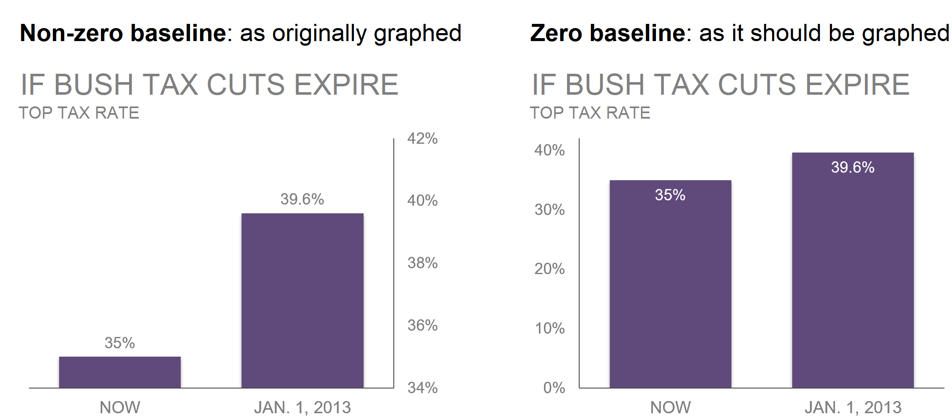
Framing
Framing is the way that a statistic is reported.
Context or comparison groups can influence the interpretation of the statistic.
Calculating proportions instead of actual numbers sometimes helps provide the true frame.
When people visualize data, they choose what to highlight and what to leave out of the visualization. These choices have framing effects that impact how others interpret the graphs and they take away from the content.
Notes:
Data Feminism pg 82
Image from Storytelling with Data – pg 51. Exaggerated version was used by fox news.

Slide 7
Misuse of Statistics
To the question "can statistics be manipulated?", we can address 6 methods often used - on purpose or not - that skew the analysis and the results. Here are common types of misuse of statistics:
Faulty polling
Flawed correlations
Data fishing
Misleading data visualization
Purposeful and selective bias
Using percentage change in combination with a small sample size

Slide 8
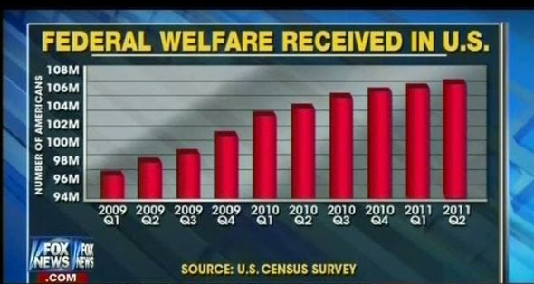
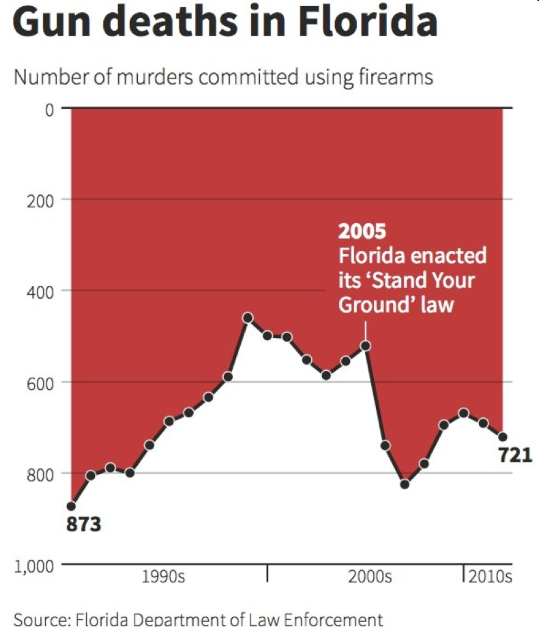
Notes:
Florida graph was meant to use the same imagery as a graph that charted deaths in Iraq (blood dripping) but that design aspect did not carry over into their graph which made it look misleading even though it was not intended to be that way according to the creator.

Slide 9
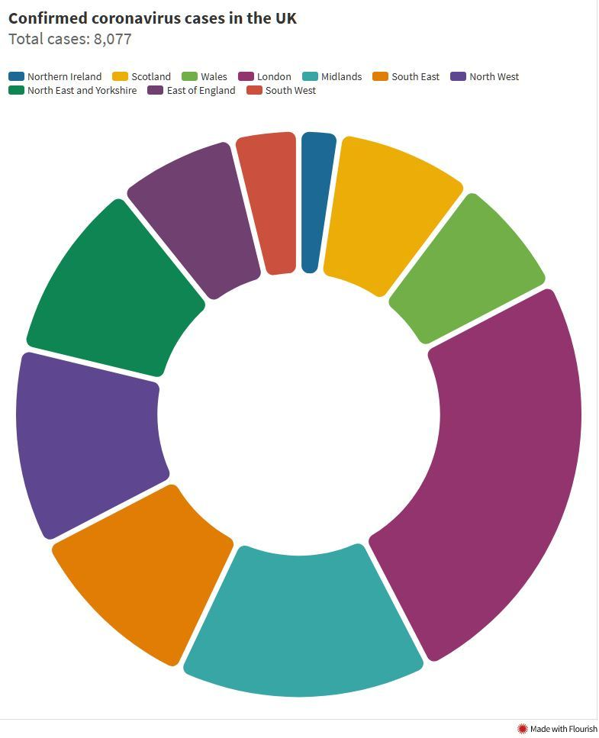
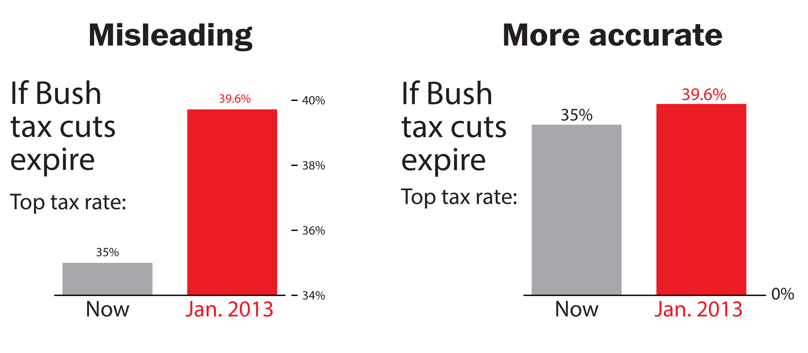
Avoiding bad graphs
Notes:
Bad graphs: https://venngage.com/blog/bad-infographics/
Bad graphs can be different than misleading graphs. Some people just aren’t very good at conveying information. Some people are good at conveying information in ways to intentionally misrepresent the data.

Slide 10
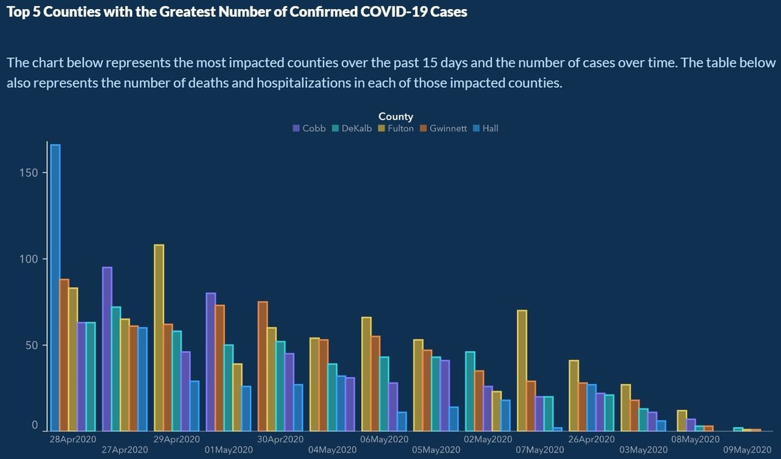

Slide 11
Measurements Matter
A city reports that one specific street recycles 2.2 times as much as any other street.
Are the streets the same length?
Do equal numbers of people live on the streets?
Alternatives:
Recycling amount per living unit
recycling amount per person
Compare it to the amount of trash
Notes:
Measuring recycling at the street level isn't a useful statistic unless streets are otherwise identical.
We want to adjust the amount recycled to take into account the number of people on the street.

Slide 12
Example – Water Usage
Some places compare themselves to other districts or cities when defending their water usage
Total water usage is down! (but population may have also decreased so the amount of water used per person may have actually increased)
Total water usage for a town is lower than everyone around us! (but very few people live in the area due to large houses with lawns and many golf courses. The per person water usage becomes astronomical compared to other locations)
Alternatives:
- water use per acre when considering different land uses
- Calculate per capita usage instead of raw numbers
Measuring the water used per capita per day.
Has that amount been increasing or decreasing per person as the population has changed?
Notes:
Findings show that water usage is highest for wealthy neighborhoods with large properties.

Slide 13
Reddit Example on CO2

Slide 14
Discussion
What is the role of statistics and data analysis in public policy, public administration, and civic technology?
What examples do you think of? What have you seen lately?
Why does it matter?
Notes:
Other examples:
Travel time and congestion – major road project may be completed and travel times may not change BUT maybe extra cars are now on the road so the carrying capacity increased.
(There’s a lot of research and theory on congestion – adding lanes does not help travel time.)

Slide 15
Week 1 - Wednesday

Slide 16
Data Sources
Primary vs. secondary data
Primary – first-hand account of an event /or time. You are creating the data yourself.
Secondary – You are using someone else’s dataset for your analysis
Who collected it, how was it collected, why was it collected?
The data that shapes information systems are created by a small group of people
Data created by dominant groups and their perspectives influence the decisions being made during the data collection, cleaning, and analyzing process
If you don’t face daily struggles, you fail to notice a lot of things that cause problems for other people (workplace accommodations for mothers, accessible entrances, )
Limits the ability to predict and prevent harm, identify existing problems in the world, and to imagine solutions
Algorithms of Oppression – Safiya Umoja Nobel: gender and racial biases are encoded
Data Feminism – Catherine D’Ignazio & Lauren F. Klein
The Library of Missing Datasets – Mimi Onuoha
Notes:
The Library of Missing Datasets
Data Feminism – pg 33
Joy Boulamwini (MIT graduate student) noticed that the facial-analysis software she was working on for a class project couldn’t recognize her face. The AI had used a dataset of mostly white faces for learning. Only 4% of the faces in the dataset were of black women.

Slide 17
Secondary Data vs. Big Data
Observational Data: info collected without the presence of an explicit experiment
Surveys, government administrative data, nonprofit services, etc.
Obtained by combining several datasets.
Takes advantage of differences within populations, or policy changes over time and geography to estimate how effective a service or intervention is.
“Big Data”: Analysis of massive datasets, scraping, twitter data, etc.
Harder to get data that accurately represents the whole of a population (like a country or a state)
Phone records & locations: can be used to study traffic patterns and movement, but what about people without phones?
Credit card transactions: shows differences in spending across socio-economics groups, but what about those that use cash?
This remains a large problem for effectively using big data that is not originally meant for social science (sometimes called “found data”).

Slide 18
Accessing Public Data
ICPSR – Archive of data used in social and behavioral science research. You can search topics and phrases and filter by data format, funding agency, year published, etc.
Chicago Data Portal – 311 calls, demographics, parks, city employees, permits, and locations of libraries, parks, schools, etc., plus any more topics and datasets
Data.gov – NASA, EPA, Defense, FEMA, + other government departments and their open data
UIC's data sources - UIC has a list of data sources of various types categorized as "Research Tools" and "Policy Documents." If you don't remember what your options are, this is a good place to start. Links to HUD, American Community Survey, USA Gov, CMAP, National Low Income Housing Coalition, Chicago Data Portal, just to name a few. UIC also allow students to access other large data repositories such as ICPSR, Policy Map, and more.
Notes:
All of these are secondary data sources.

Slide 19
Opening data in Excel
Common file types:
.csv
.xlsx .xls .xml .xlsb .xlsm
.txt
.ods
File types Excel can’t open:
.dta, .sav & more (But R can open and use these files!)
Notes:
If I find a really great study on ICPSR, but they only include Stata code (.dta) then I can’t use that in Excel. ☹

Slide 20
Files in Excel
Look at the file. How is it formatted? How many rows? How many columns?
Is data separated by commas, spaces, semi colons?
Import data:
Open Excel > Data > From Text/CSV > Select File
Delimited text file: each item on a line of text is separated by a character (the delimiter). Most common type uses a comma (,) but other characters can be used too.
Fixed-width text file: All items are a set amount of space apart. Visually, the data appears in columns because of the spacing.

Slide 21
CSV → Excel Reminder
If you format or create graphs in a CSV file and save/close it, only the text in the file will be kept.
Save As -> Excel file (.xlsx) if you want to save your formatting and graphs!!

Slide 22
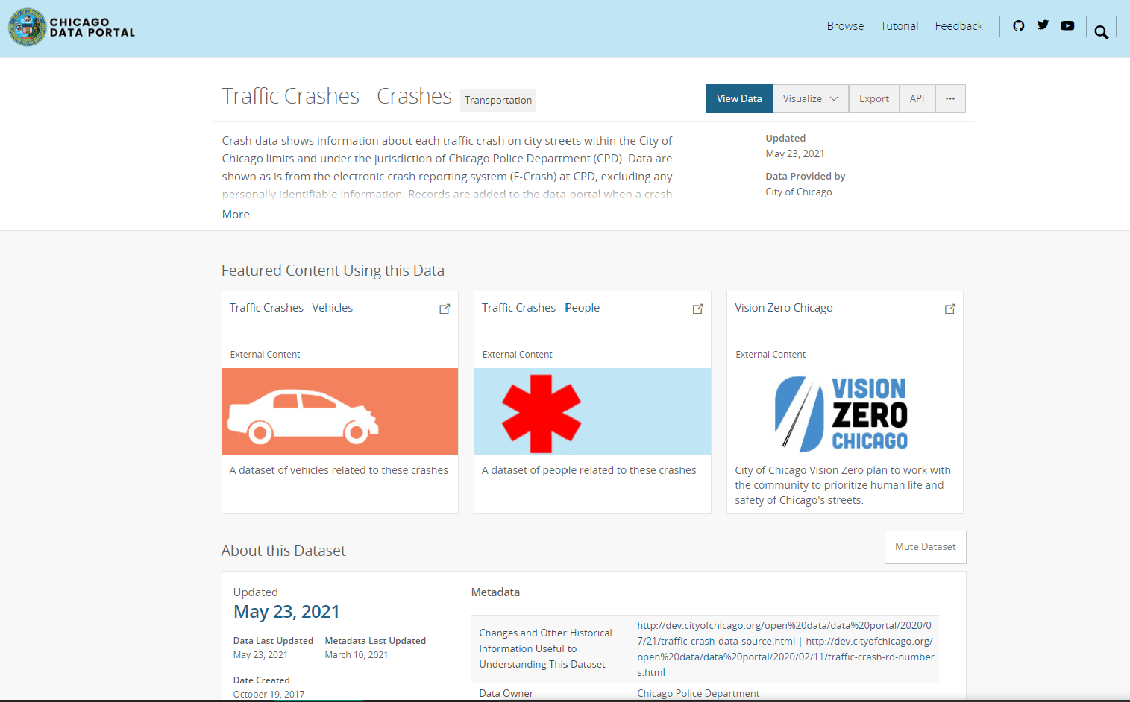
Download Chicago Traffic Accident Data
Research Question: How did COVID-19 restrictions impact traffic in Chicago?
Hypothesis: Work restrictions led to fewer drivers and therefore fewer accidents.
Went to Chicago Data Portal
Chicago data portal also has a github
Before we download, let’s click “View Data” to see if this is what we want.
Notes:
Went to Chicago data portal, searched “Traffic” and it is the first result “Traffic Crashes – Crashes”

Slide 23
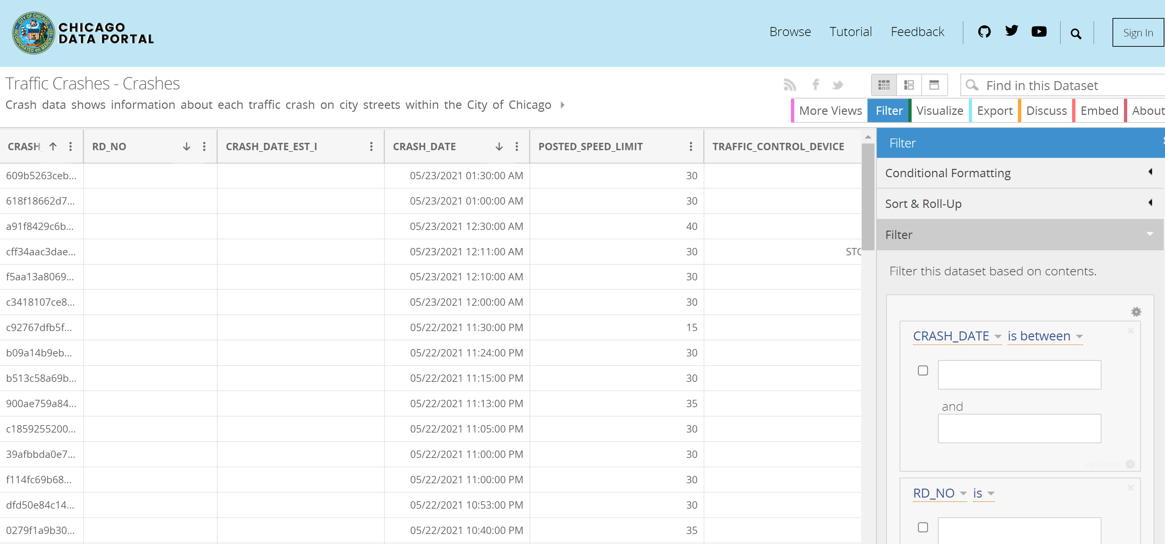
Notes:
Chicago’s data portal has a relatively user-friendly interface that allows filtering, sorting, formatting, and visualizing of data before you even download the data. Many data sources do not have this. You would instead have to read the description of the dataset, descriptions of the variables, and other information provided to determine if it was what you wanted to analyze.
API information: https://dev.socrata.com/foundry/data.cityofchicago.org/85ca-t3if

Slide 24
Download Tips
Take advantage of websites that let you select which variables you want or the time frame you are interested in!
If you download the full Crash dataset, it is ~500,000 observations and ~ 250 MB in size (1/4 of a gigabyte)
Most computers will be very sad if you open this file in excel. Even opening it takes a while. Analysis will be painful.
Fun Fact: Excel can’t open anything larger than 2 GB
If you filter the Crash data on the Chicago website from 1/1/2019 to 1/1/2021, then you “only” have ~209,000 observations
File size is much smaller and easier to work with

Slide 25
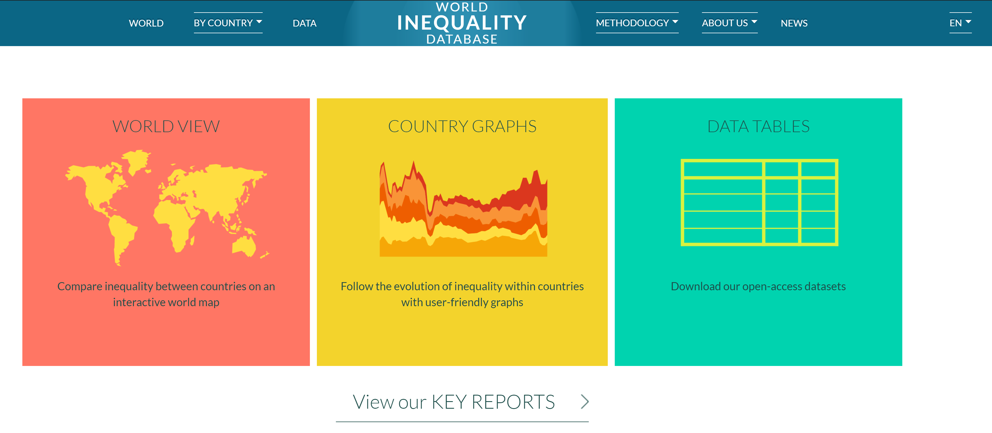
WID
Notes:
https://wid.world/
Data Tab

Slide 26
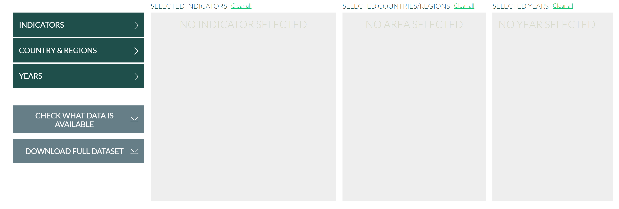

Slide 27
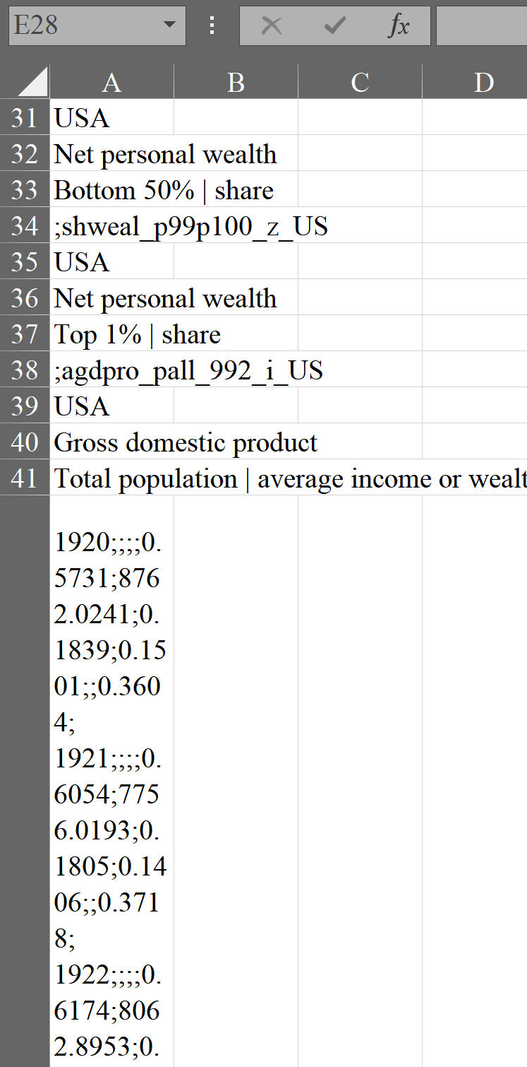
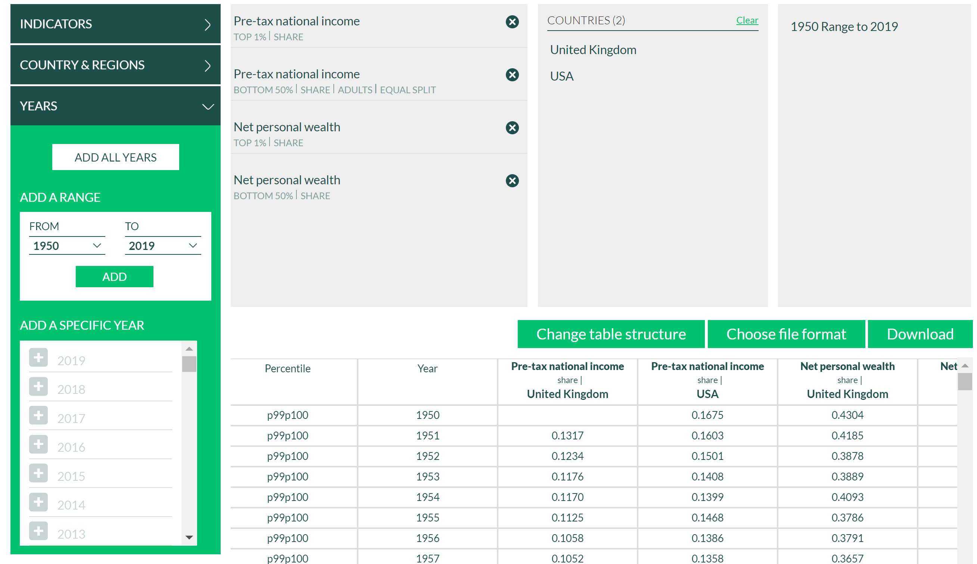
Downloading WID File

Slide 28
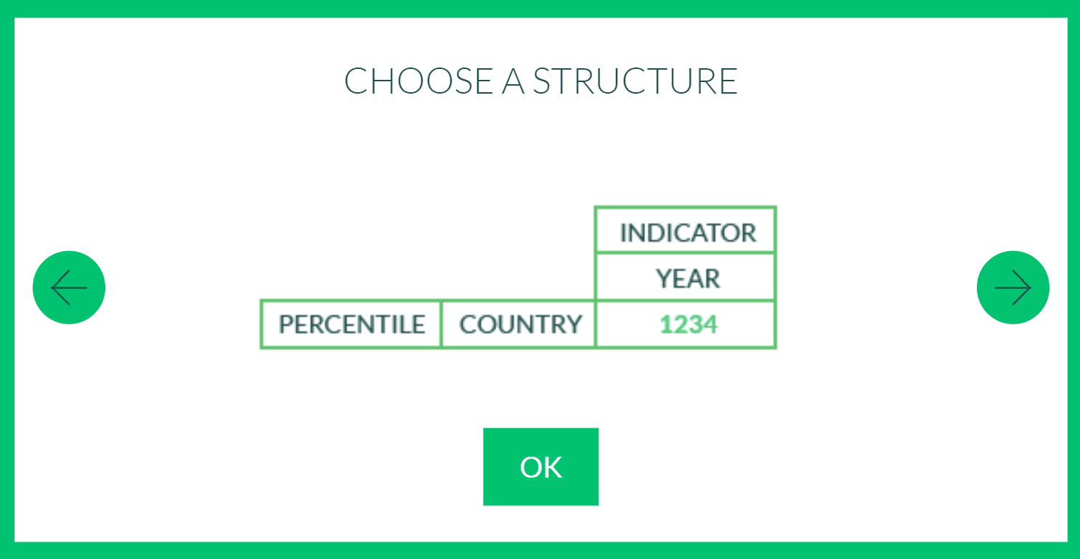
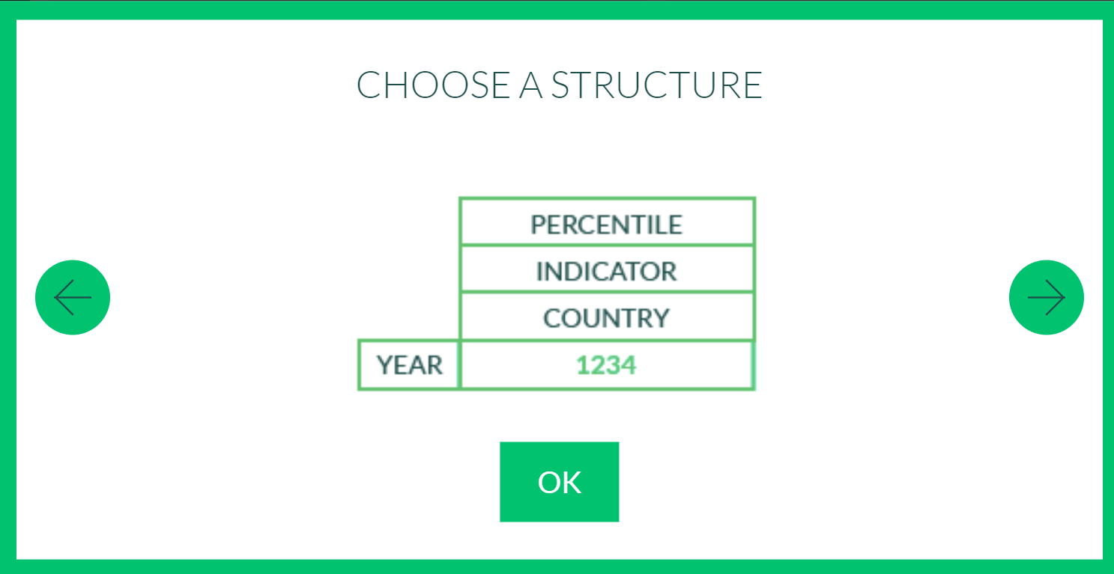
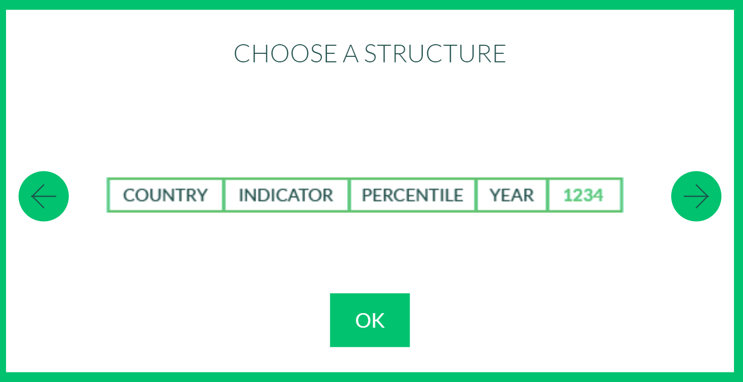
Data Structure
Lets you choose how to structure your data!

Slide 29
WID

Slide 30
Complete Handout before Leaving

Slide 31
Week 2 – Data Management

Slide 32
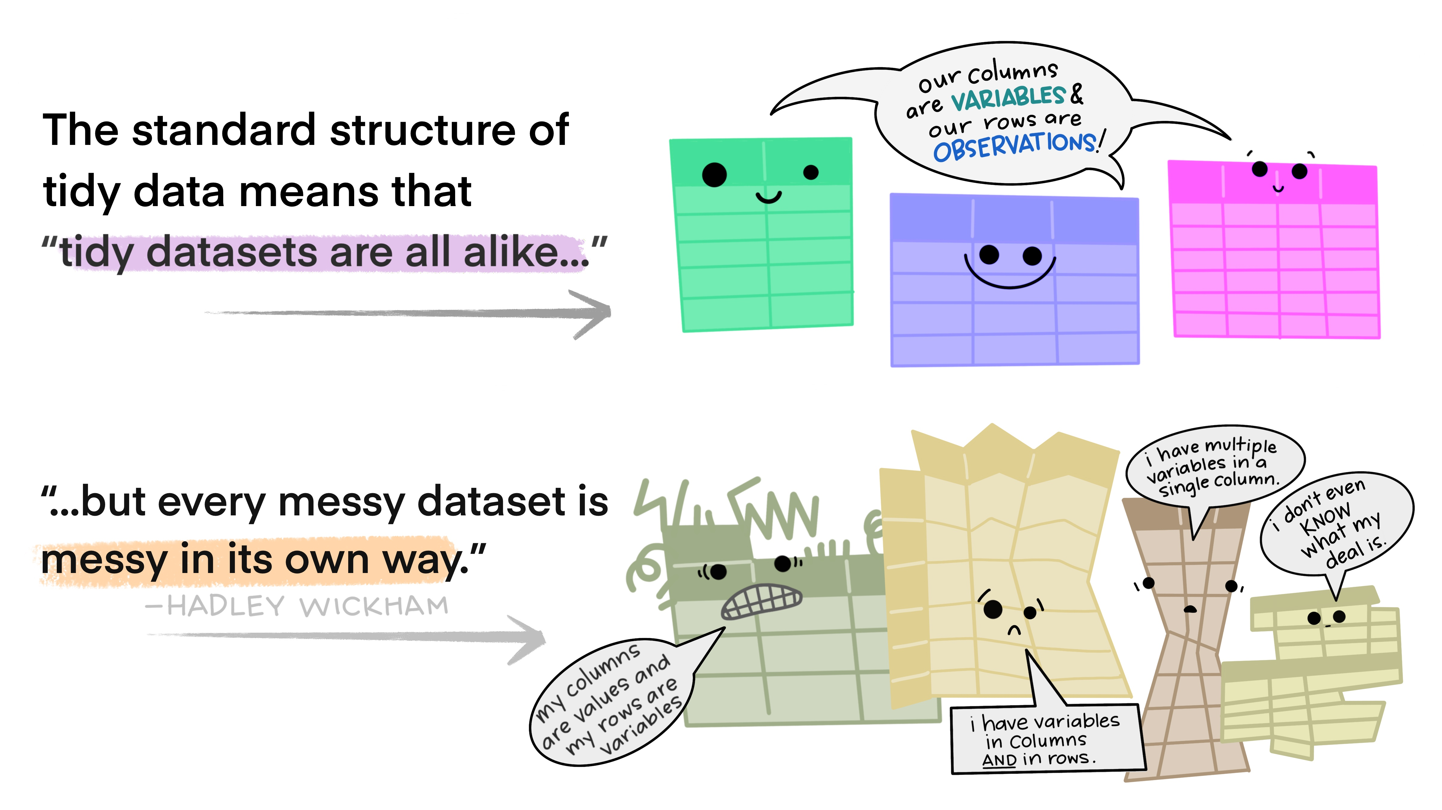
Data Management
Data will very rarely be organized the way that you want
.
Notes:
Image created by Allison Horst: https://github.com/allisonhorst/stats-illustrations

Slide 33
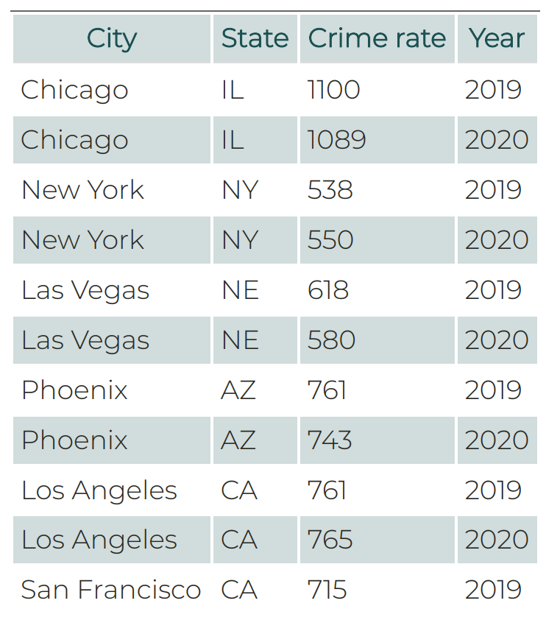
Data Structure
Good (aka “Tidy”) Data
Each variable should have its own column
Each observation must have its own row
Each value must have its own cell
Rectangular Data: Rows indicate observations, or cases, and columns indicate variables
Excel tables
R dataframes or tibbles
Notes:
Note: A variable is a quantity, quality, or property that you can measure. An observation is one unique unit of analysis (e.g., a country, a country in a given year). This depends on your analysis Values are all the individual cells in your datasets which are stored in variables or observations

Slide 34
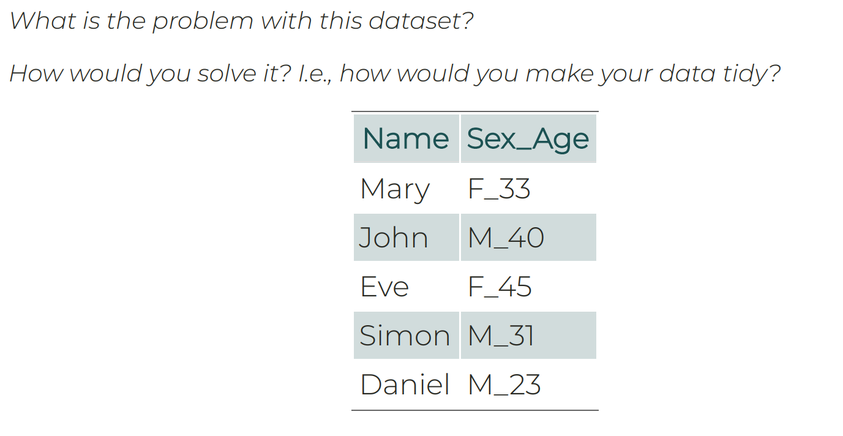
Data Cleaning Examples
Add photos of disaster declarations – state – year in wide and long formats
Notes:
Why would this data be challenging to work with?
How would you improve it?
What are the variables of this dataset?

Slide 35
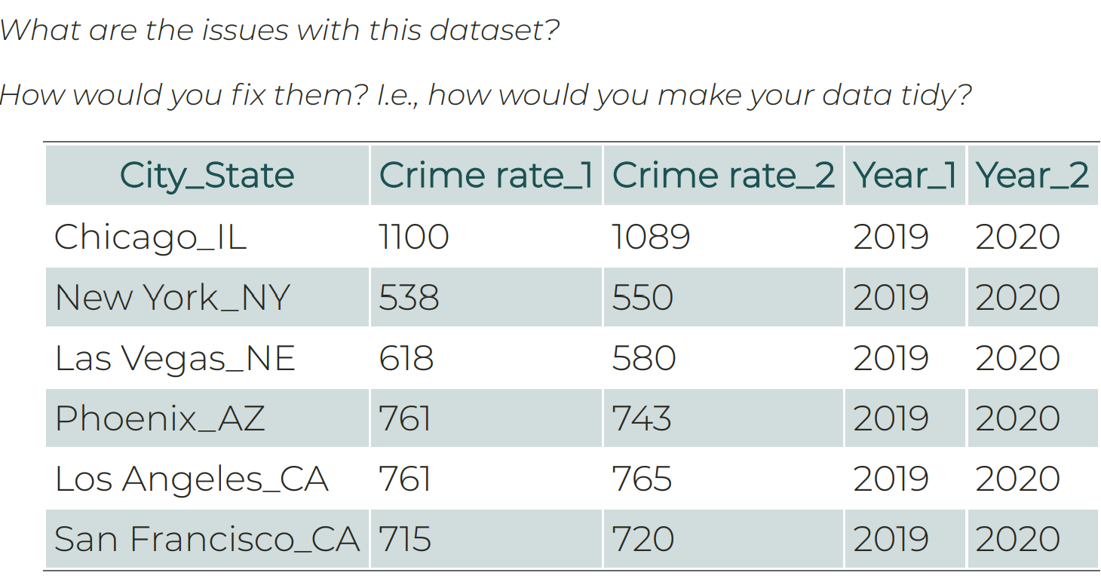
Example
Why would this data be challenging to work with?
What are the variables of this dataset?
How would you improve it?
Notes:
First separate city and state into separate variables. Then you want year as one variable and the crime rate as another variable.
Once we get to R, we will use commands like pivot_wider and pivot_longer to do what we described here. Each row is one observation (a city during a certain year)

Slide 36
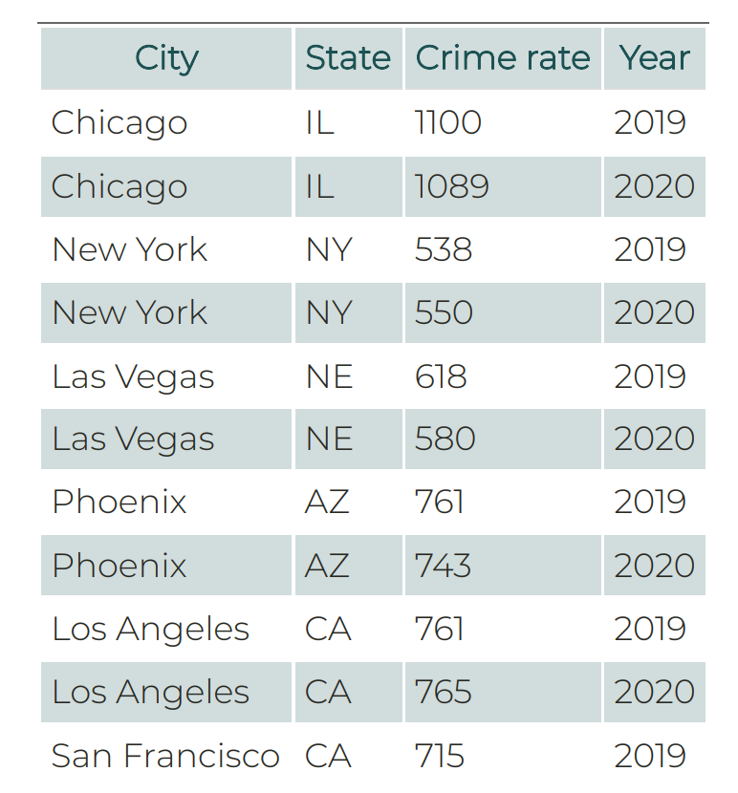

Slide 37
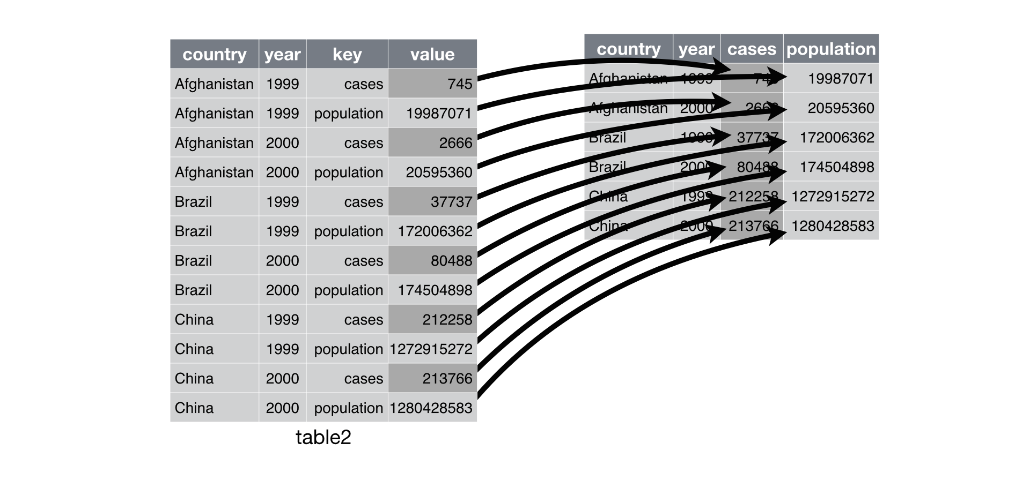
Each column is a variable
Notes:
Images from Chapter 9 – Tidy Data with tidyr
Data from gapminder

Slide 38
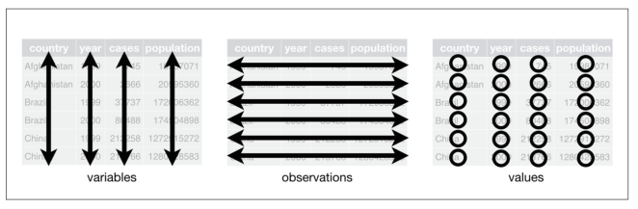

Slide 39
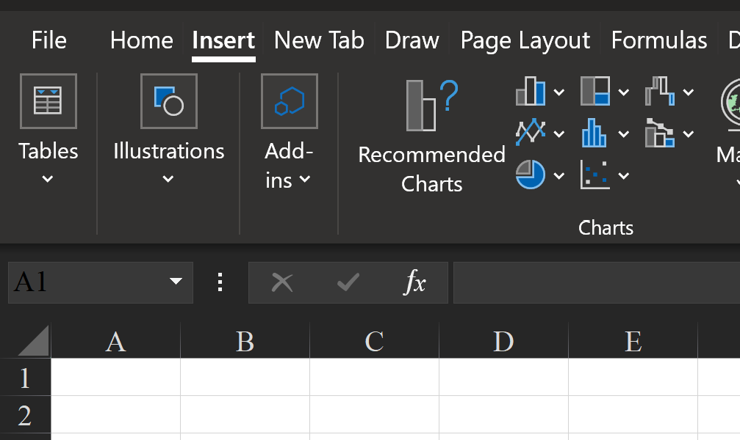
Excel Tables
An Excel table is a rectangular range of cells used to store data
- Tools for entering, editing, analyzing data
Create an Excel Table:
Select all data in excel sheet > Insert > Tables > Table
- Or click on any cell in the data, Insert > Table
Notes:
Data: Traffic_Crashes_SMALL
I only kept crashes that happened on Oct. 31 (310 of 222,718 observations)

Slide 40
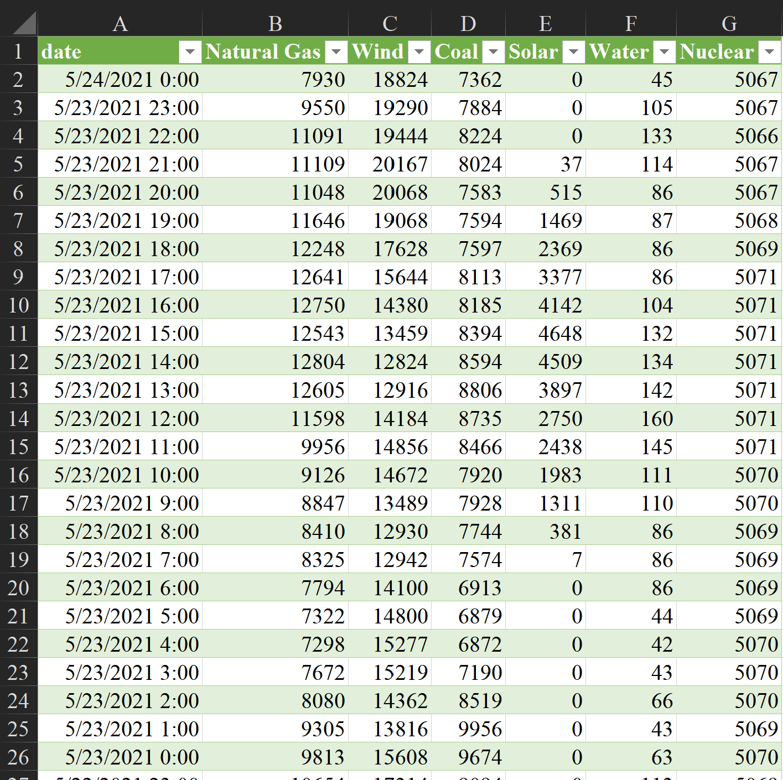
Sort & Filter buttons
Column Headers
Table Column
Table Row
Table Cell
Notes:
The row is your observation.

Slide 41
Pivot Tables
Pivot tables are tables in Excel that summarize data from the original table.
Ex. If you have the amount of electricity used by each household and business in county, you could calculate the average amount of electricity used by each county or state.
Pivot tables help go from long format to wide format
In R, the commands are pivot_longer() and pivot_wider()

Slide 42
Pivot Tables & Pivot Charts
Insert > Pivot Table > Select all in the “Table/Range” area > OK
Select the variables you want to summarize in PivotTable Fields
- What does each row represent?
- What does each column represent?
Pivot Charts do not choose the appropriate graph for you.
Shortcut for Pivot Chart ➔ Click on any cell in the pivot table and F11
Notes:
Excel for Dummies pg 177
Chapter 9

Slide 43
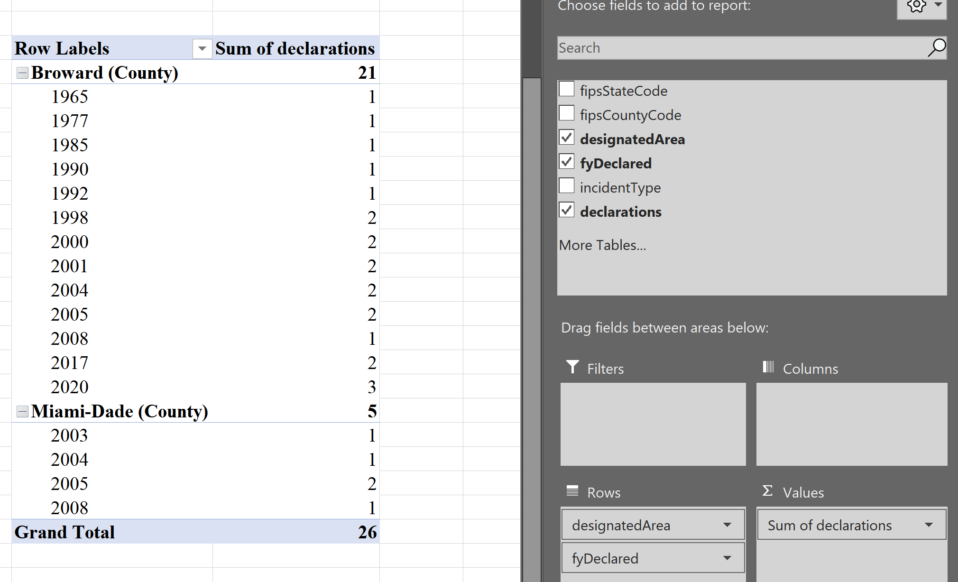

Slide 44
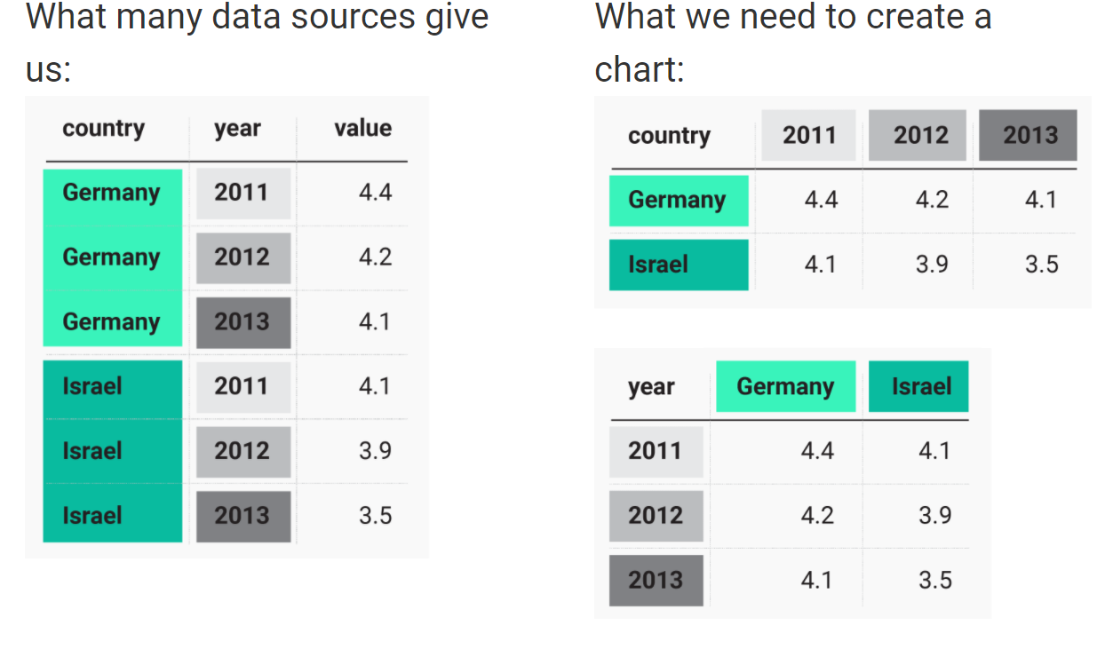
Wide vs. Long Format
Long Format: Each observation is in its own row
Allows you to add as many variables as you want
You can look at responses for an age group, in a country, during a specific year.
Wide Format
Multiple values in a row (multiple years, countries, etc.)
Only 2 variables at a time (country and year, gender and age group, etc.)
Notes:
Image from https://blog.datawrapper.de/pivottables/
Pivot Tables can do this!

Slide 45
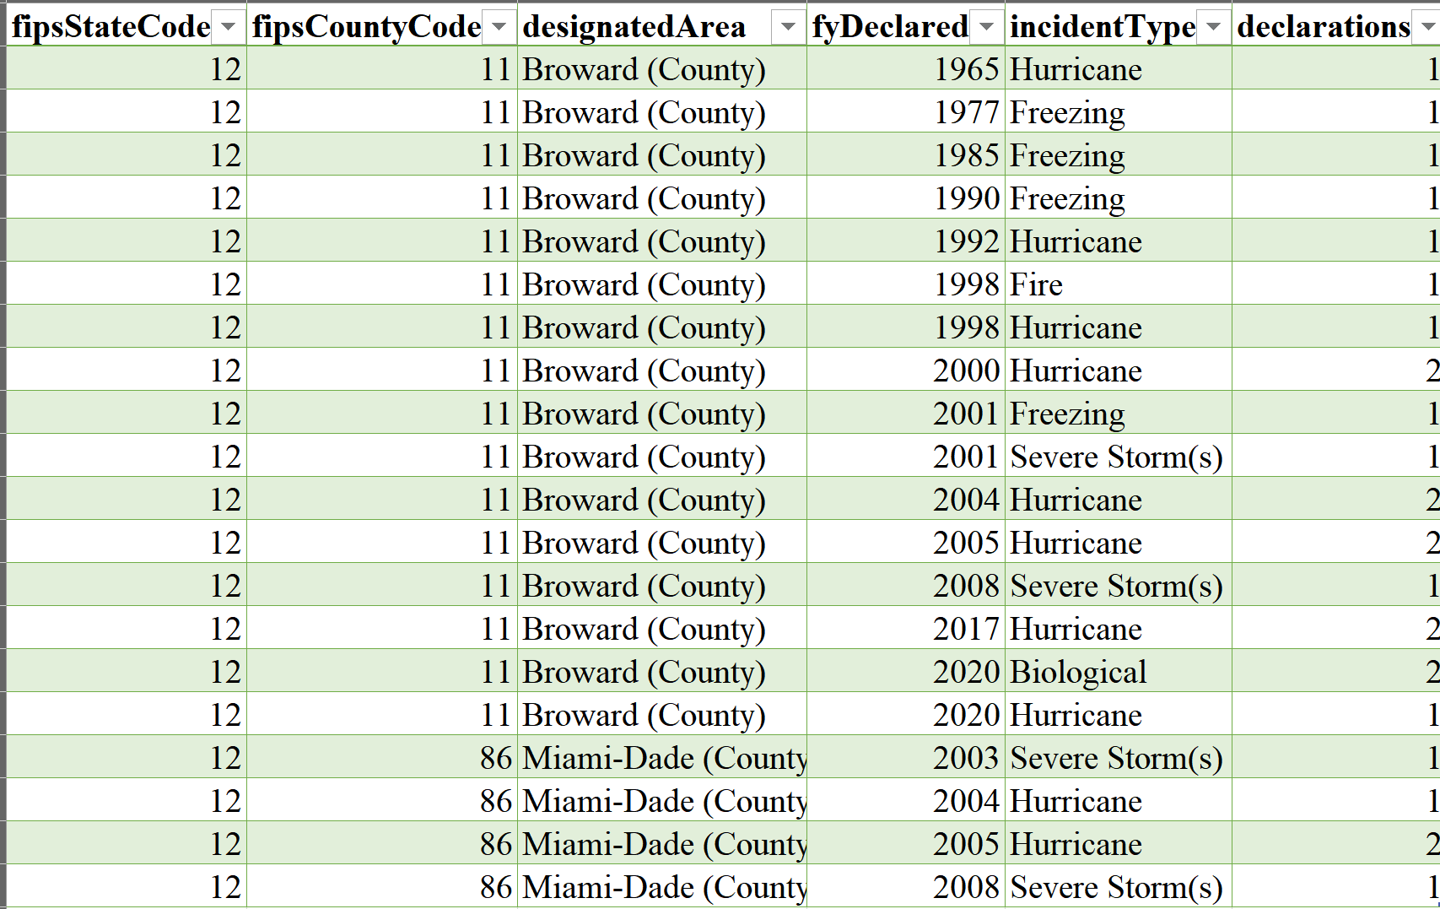
Notes:
Which format is this?

Slide 47
Data Cleaning
Common Steps:
Delete unnecessary columns or create a separate file containing only columns you need
Delete unnecessary rows
Resize columns
Resize rows
Column format: Text, numeric, percentages, etc

Slide 48
Common errors in datasets
Duplications: where one row contains identical/similar information to another row.
‘NA’ misclassifications: where empty values are misclassified as known values or vice-versa.
Erroneous answers: where incorrect values are entered, either accidentally or deliberately (a common effect of compulsory questions that cannot be answered).
White space and alphabetical case errors: where values appear to mean the same thing but are classified differently due to white space or alphabetical case.
Spelling mistakes, typing errors, or special character errors: where values appear to mean the same thing but are classified differently.
Inconsistent time formats: where dates/times have been inputted in several different time formats, making it impossible to make time-based calculations.
Data merging ambiguity: where information that could be recorded in different columns is merged into one column, making the information difficult to interpret.
Data recording ambiguity: where information is recorded in different ways (e.g. giving a range of values rather than a single value).

Slide 49
Download Chicago Traffic Accident Data
Research Question: How did COVID-19 restrictions impact traffic in Chicago?
Hypothesis: Work restrictions led to fewer drivers and therefore fewer accidents.
Went to Chicago Data Portal
Chicago data portal also has a github
Before we download, let’s click “View Data” to see if this is what we want.
Notes:
Use Traffic_Crashes_SMALL

Slide 50
Notes:
Chicago’s data portal has a relatively user-friendly interface that allows filtering, sorting, formatting, and visualizing of data before you even download the data. Many data sources do not have this. You would instead have to read the description of the dataset, descriptions of the variables, and other information provided to determine if it was what you wanted to analyze.
API information: https://dev.socrata.com/foundry/data.cityofchicago.org/85ca-t3if

Slide 51
Looks good, let’s use it! Downloaded Traffic Crashes Dataset
If we want to know ____ what do we need to answer that question?
Notes:
The file downloaded on 5/23/2020 was 88.3MB large. For some computers, this may be a large file to open and manipulate in Excel without frustrating lags.
To answer the research question and make the data more user friendly, let’s delete rows that are not needed. I deleted all observations before 2019 and columns that were unnecessary for the class examples.

Slide 52
Descriptive Statistics
Describing the data
Maximum value
Minimum value
Range: Maximum value – minimum value
Sum: Adding together a range of values
Frequency: Number of observations
How many people got vaccinated in an area?
What is the median income?
What is the average age of someone within a program?
What is a school’s graduation rate?
How many meals were distributed at the local food shelf?
Notes:
How many people got vaccinated in an area?
What is the median income?
What is the average age of someone within a program?
What is a school’s graduation rate?
How many meals were distributed at the local food shelf?

Slide 53
Exploratory Graphs
- Mostly made for you and your team
- Draw quick information from your data in a more intuitive way
- Several uses: better understand your data, find patterns in your data, suggest modeling strategies, debug your analysis
Three rules to keep in mind even when making exploratory graphs:
1. Data are displayed appropriately (i.e., the graph type matches the data type)
2. Clearly-labeled graph (e.g., axes' labels and title)
3. Axes that are not misleading
Notes:
Storytelling with Data pg 20

Slide 54
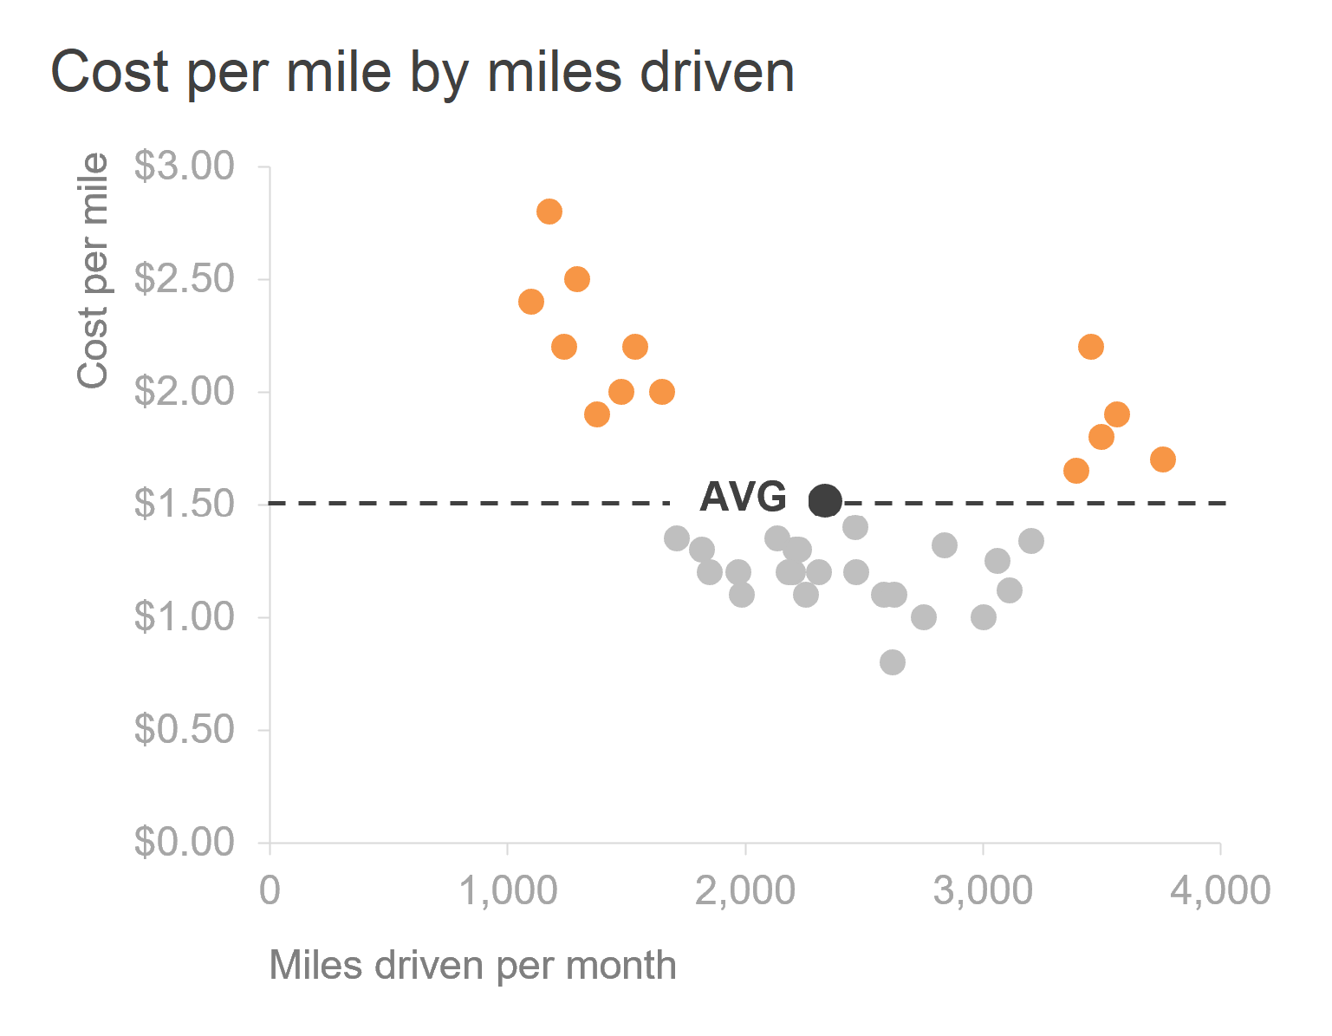
Explanatory Graphs
These are the fancy graphs that you see all around
- The "reader" is the audience
- Visually pleasing, well-designed graphs
- Usually created after your analysis
- It can take quite some time to get a graph "right“
Think National Geographic or The Economist graphs
Notes:
Storytelling with Data pg 111

Slide 55
Descriptive Statistics Practice
- How many crashes occur at different speed limits?
- Does weather impact traffic accidents? (Consider the number of days that are clear vs. foggy)
- Crash totals for each year or month?
- Hour of the day with the most accidents?
Notes:
Most of data analysis involves statistics.

Slide 56
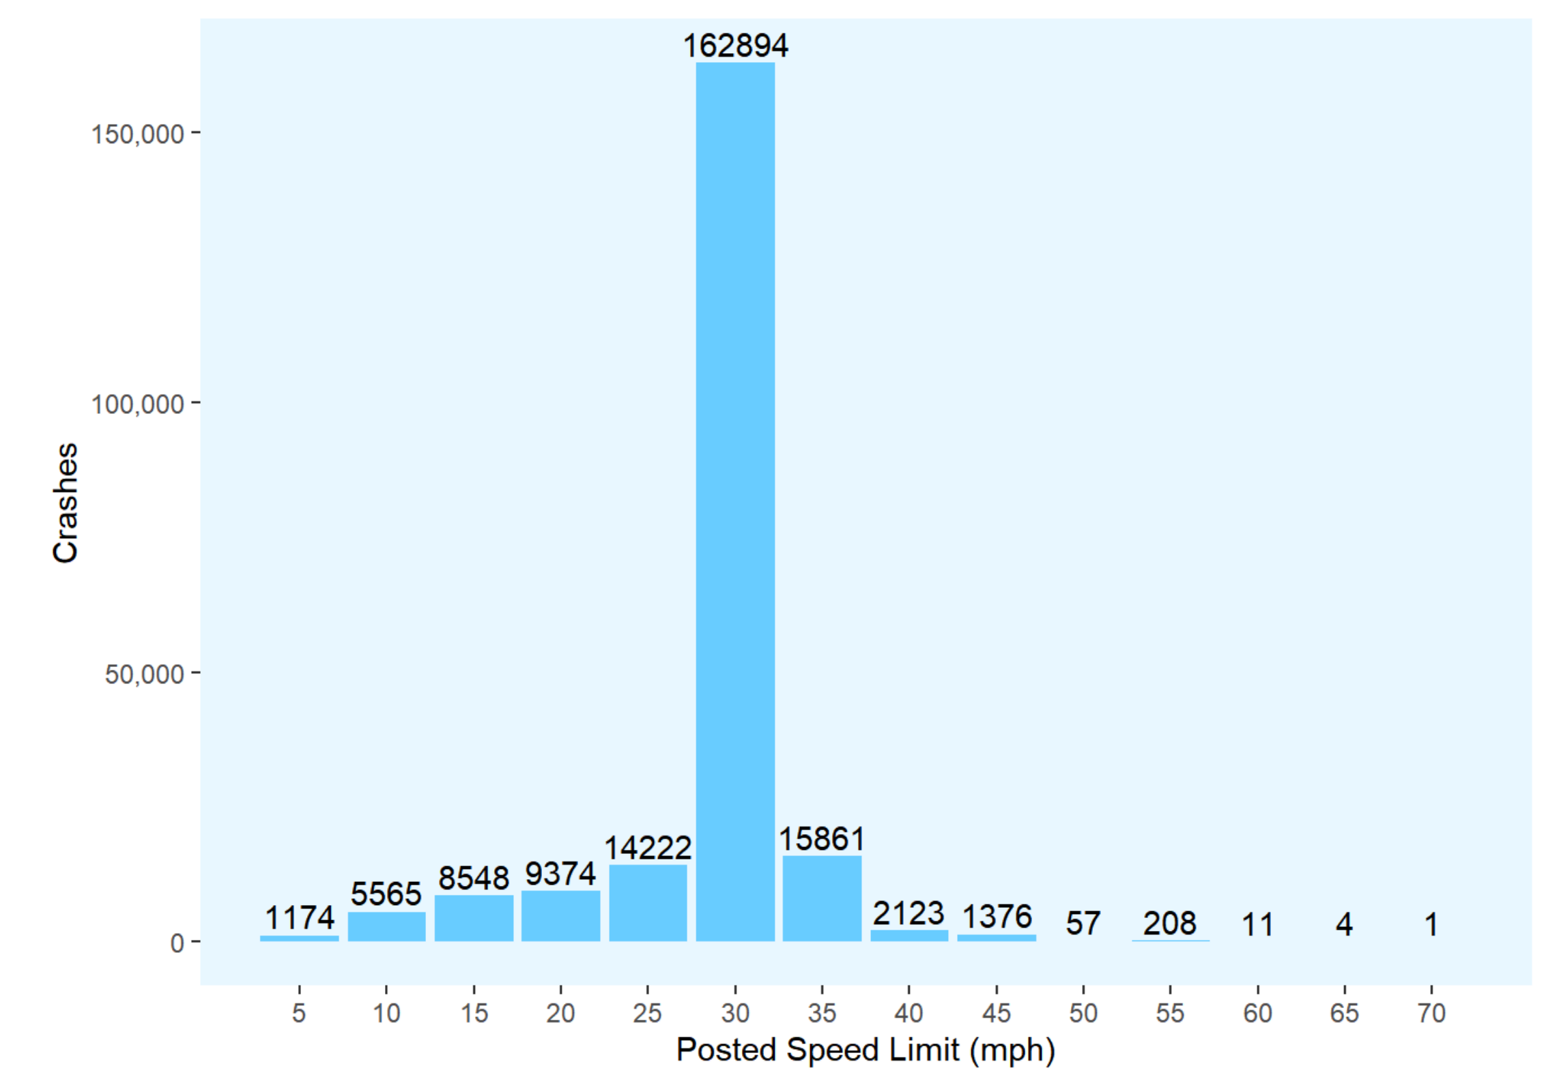
Chicago Traffic Accidents

Slide 57
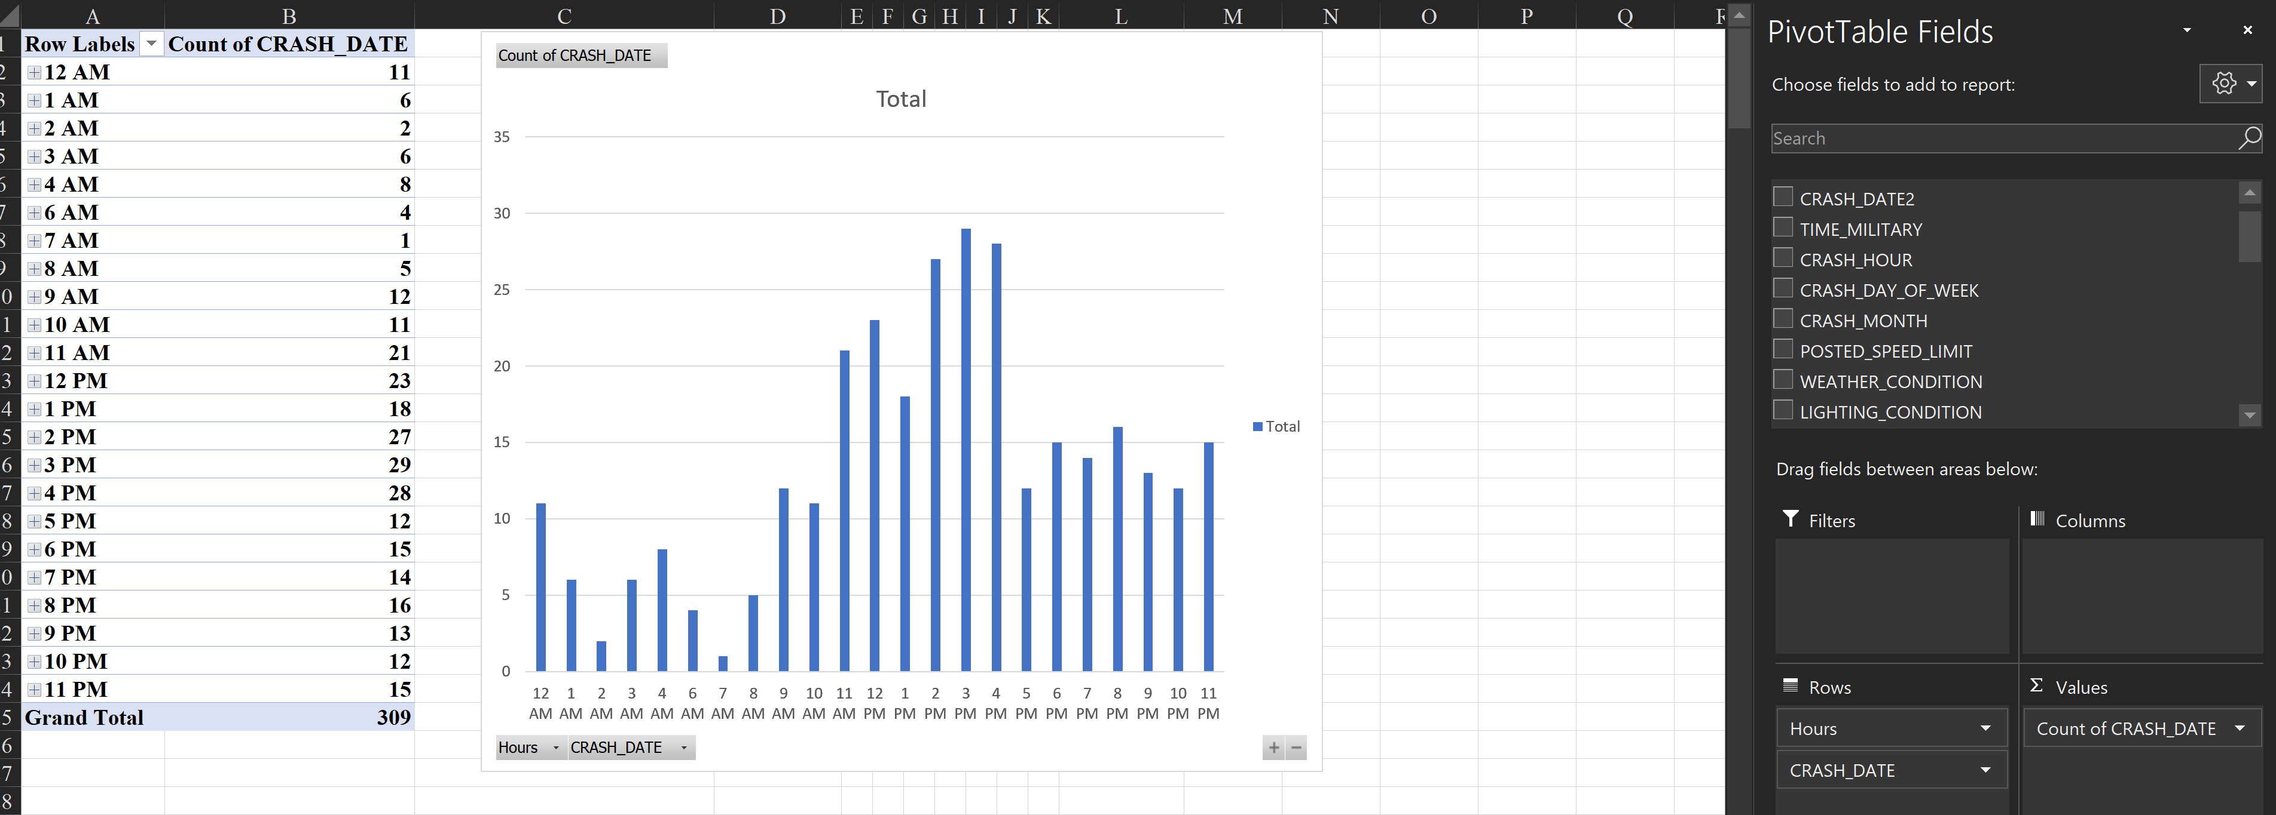
When did people have an accident?
Insert > Pivot Chart > Your table name should be in the box (Mine was Table1)
Notes:
Axis – Hours
Values – Count of observations

Slide 58
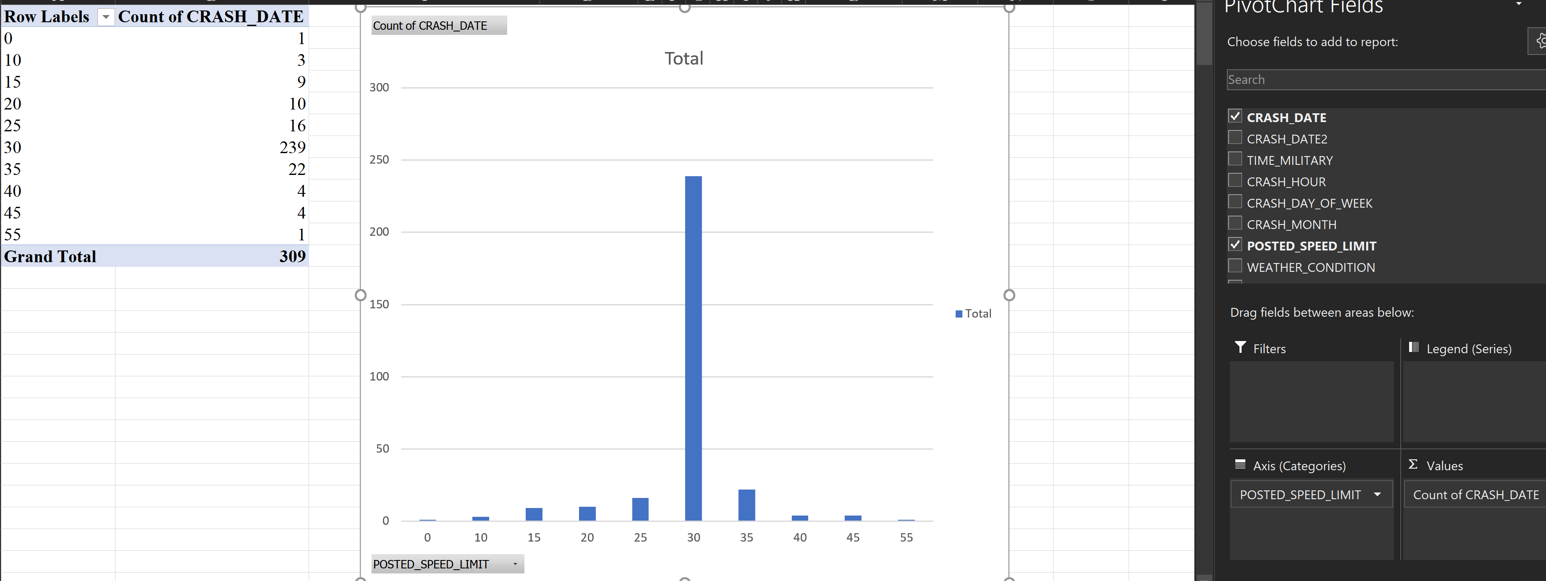
What were the posted speed limits?
Notes:
Axis – posted speeds
Values – Count of observations
Graph shows number of accidents that occurred within each posted speed limit.

Slide 59
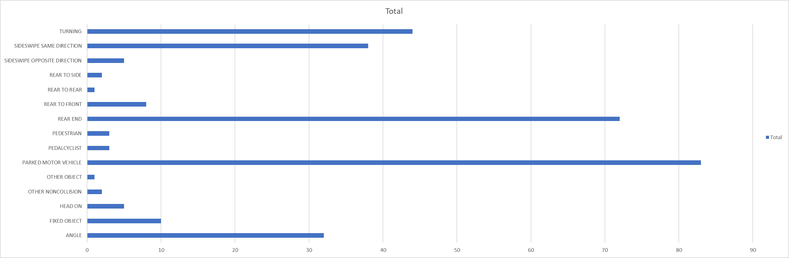
The Vertical Chart worked well when we had data with short labels, but what if we wanted to look at the weather recorded during the accidents?
Right Click > Change Chart Type
Notes:
Was done alphabetically by default

Slide 60
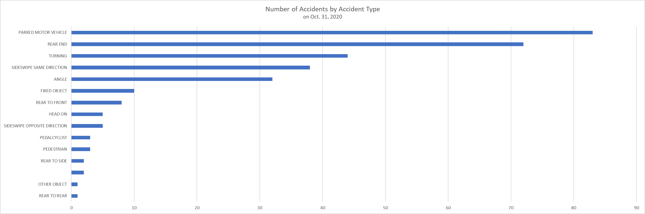
Horizontal Bar Graphs
One of the best for categorical data
If categories have a natural order (0-10 years old, 22-20 years old, etc.), keep categories in order
If categories do not have a natural order, use either ascending or descending order
If smallest is important, put it at the top and vice versa
Notes:
Storytelling pg 57

Slide 61
Cleaning Data
Date Column

Slide 62
Separating Cell Information
Insert a column next to the one you want to split
Data > Data Tools > Text to Columns > Convert Text to Columns Wizard > Deliminated > Next > Choose the delimiter to define places where you want to split the cell content
https://support.microsoft.com/en-us/office/split-a-cell-f1804d0c-e180-4ed0-a2ae-973a0b7c6a23

Slide 63
Combining Cells in Excel
https://support.microsoft.com/en-us/office/combine-text-from-two-or-more-cells-into-one-cell-81ba0946-ce78-42ed-b3c3-21340eb164a6
Combine data with the Ampersand symbol (&)
Select the cell where you want to put the combined data.
Type = and select the first cell you want to combine.
Type & and use quotation marks with a space enclosed.
Select the next cell you want to combine and press enter. An example formula might be =A2&" "&B2.
Combine data using the CONCAT function
Select the cell where you want to put the combined data.
Type =CONCAT(.
Select the cell you want to combine first.
Use commas to separate the cells you are combining and use quotation marks to add spaces, commas, or other text.
Close the formula with a parenthesis and press Enter. An example formula might be =CONCAT(A2, " Family").

Slide 64
Inferential Statistics (PPOL 205)
If you have a sample of observations from a population, then you can infer, or draw conclusions, about the entire population based on the characteristics of the sample.
Surveys
Opinion polls
Accuracy: You can never be 100% sure that your inference is correct because you only have information from a subset of the population. If you sampled incorrectly, you make some incorrect assumptions.
Predicting elections before votes are in
Notes:
PPOL 205 will cover inferential methods (hypothesis testing, t-tests, confidence intervals, regression analysis), but will do so through policy-relevant case studies, real data sets, and applied assignments.

Slide 65
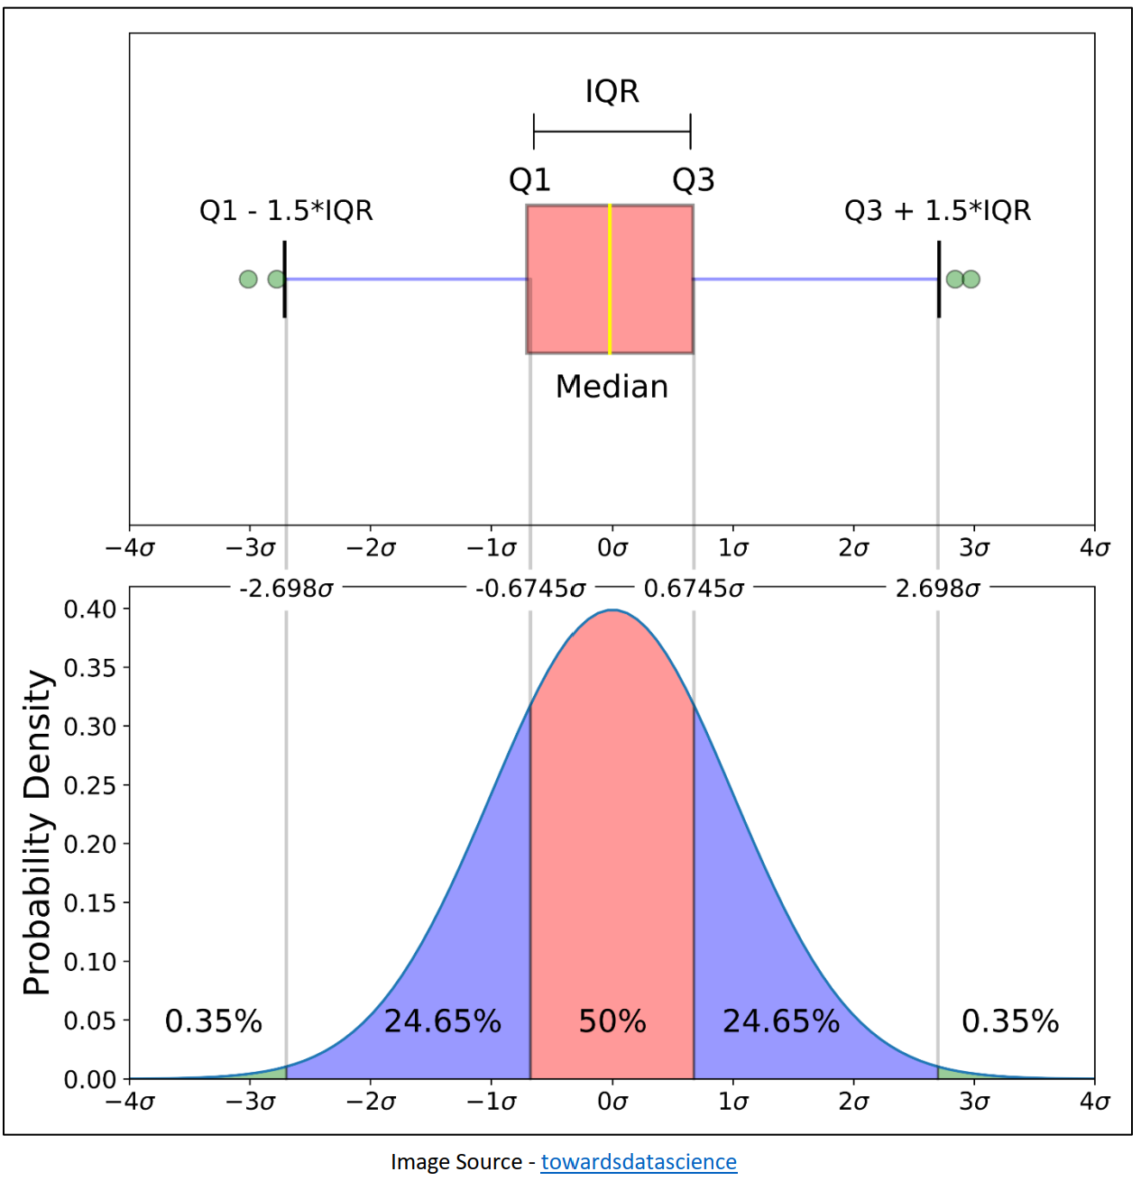

Slide 66
Week 3

Slide 67
Recap of Last Two Weeks
If you enrolled late, talk to me after class.

Slide 68
Categorical Variables
A categorical variable is made of categories. Even if a number is assigned to it for data recording purposes, the numbers do not mean anything (eg. taking the average of: 1. Blue, 2. Orange, 3. Green). This occurs most often when analyzing survey data when information is stored as numbered responses (that work for analysis) and labels (that describe the options)
Mode, Expected Value (don't cover?), Bar charts, Line charts (avoid pie charts)

Slide 69
Numeric Variables
Continuous
Age,
Ordinal

Slide 70
Types of Variables
Nominal-Level Variable: mode Ordinal-Level Variable: mode, median ‘High’ Ordinal-Level Variable (7+ Categories): mode, median, mean Interval- or Ratio-Level Variable: mode, median, mean
Continuous: Data can take on any value in an interval
Discrete: Data can take on only integer values, such as counts
Categorical: Data can be only a specific set of values rerpresenting a set of possible categories (factors, nominal)
Binary: Categorical variables with only two options (Yes/No, 0/1, true/false, etc.). Synonyms include: dichotomous, logical, indicator, booleani
Ordinal: Categorical data that has an order to it. (A range of feelings, Likert scales, etc.)

Slide 71
Variation
Variation is the tendency of variables to change from measurement to measurement
Each measurement includes a small amount of error
Visualize the distribution of a variables values to find patterns in variation
Chicago traffic speed example

Slide 72
Appropriate statistics for describing variables
Nominal-Level Variable: mode
The values have no meaning, order of categories doesn’t matter
Ordinal-Level Variable: mode, median
The values have order, the direction matters
‘High’ Ordinal-Level Variable (7+ Categories): mode, median, mean
Interval- or Ratio-Level Variable: mode, median, mean

Slide 73
Texas Winter Storm
The ERCOT dataset contains hourly megawatt amounts from multiple power sources for January and February. Publicaly available.
Potential Descriptive Statistics:
Sum of hourly megawatts for each source
Average proportion of total energy provided from each source
Daily average? Yearly average? Monthly Average? Depends on what you are trying to understand.
Long term changes in power sources? Maybe average total megawatts from each source
Short term changes in power sources? Changes in hourly or daily megawatt amounts from each source
Visualize change over time: Insert Chart > Line chart for temperature. To chart temperature and energy sources, you can make a “Combo” graph. This is largely known as a double y-axis and must be used with caution. Graphs with double axes have been used to misrepresent data because the two y axes do not share a common scale.
Policy Context: Texas Governor Greg Abbott claimed that solar and wind were to blame for the power outages and that fossil fuels were the only reliable way to power electric grids. Other conservative leaders and influential talking heads said similar things across various forms of media.
Notes:
Highlighted columns in 'Energy', Insert > Pivot Chart > Sum of each power source in the value section. It automatically sums up the total power consumption by day if date is in the x axis.
Good graphs = labels, commas indicating thousands, Title, legend, etc.

Slide 74
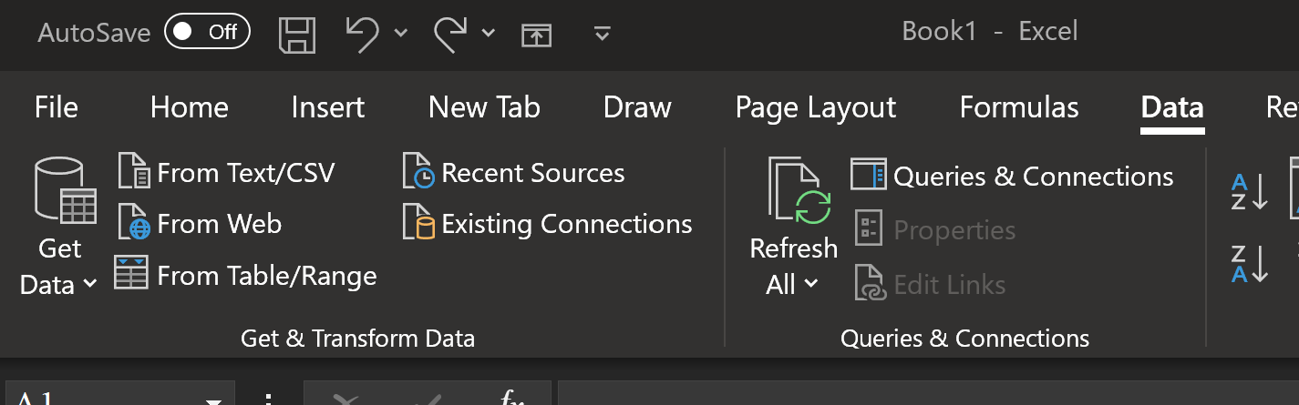
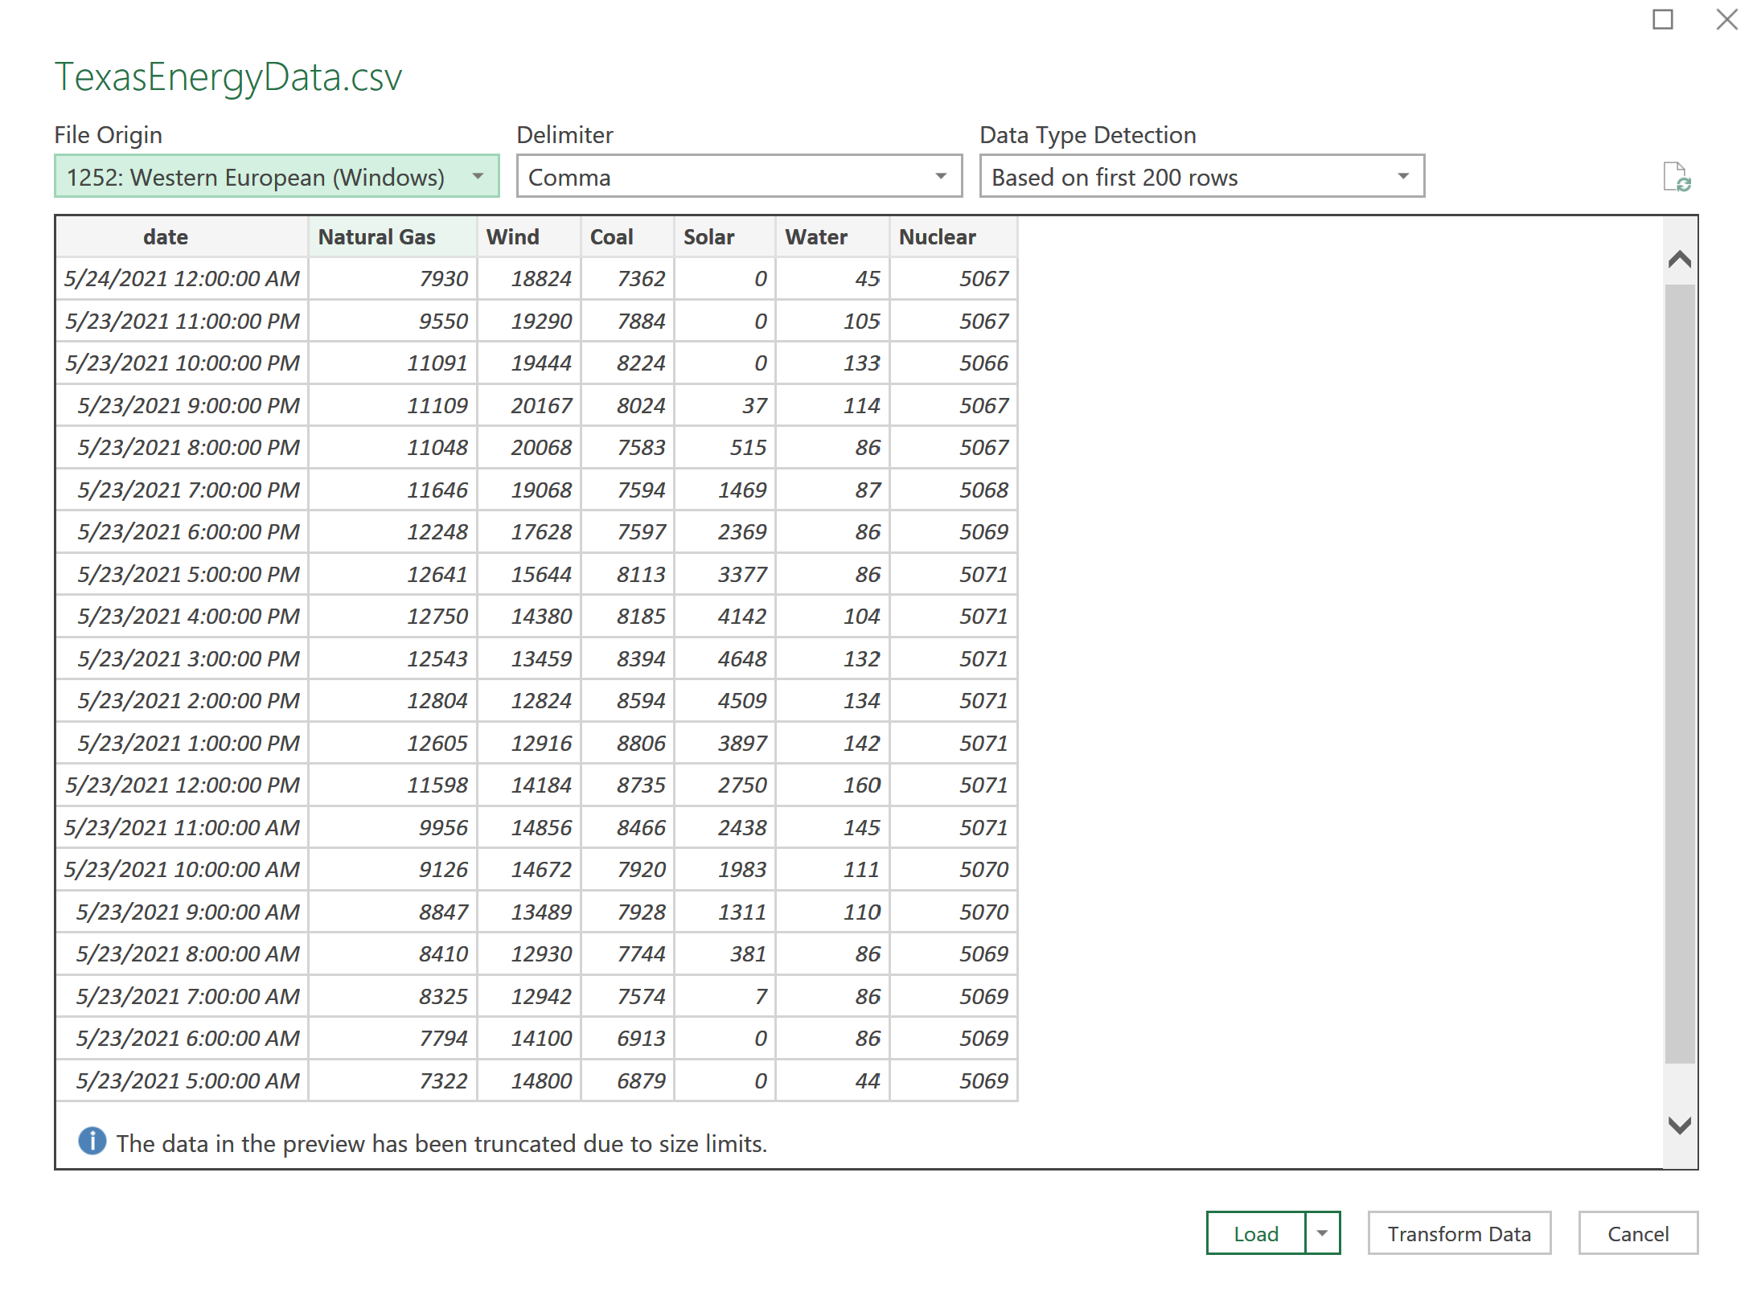
Open Excel > Data > From Text/CSV > Locate the File you want > Import > Load
The Delimiter: Most common is the comma (CSV = comma-separated values)

Slide 75
Categorical?
Numeric?
Continuous?
Ratio?

Slide 76
Central Tendency
=AVERAGE()
=VAR()
=MEDIAN()
=MODE()
=COUNTCOL()
=SUMCOL()
=COUNTROW()
=SUMROW()
Notes:
https://fivethirtyeight.com/features/police-misconduct-costs-cities-millions-every-year-but-thats-where-the-accountability-ends/

Slide 77
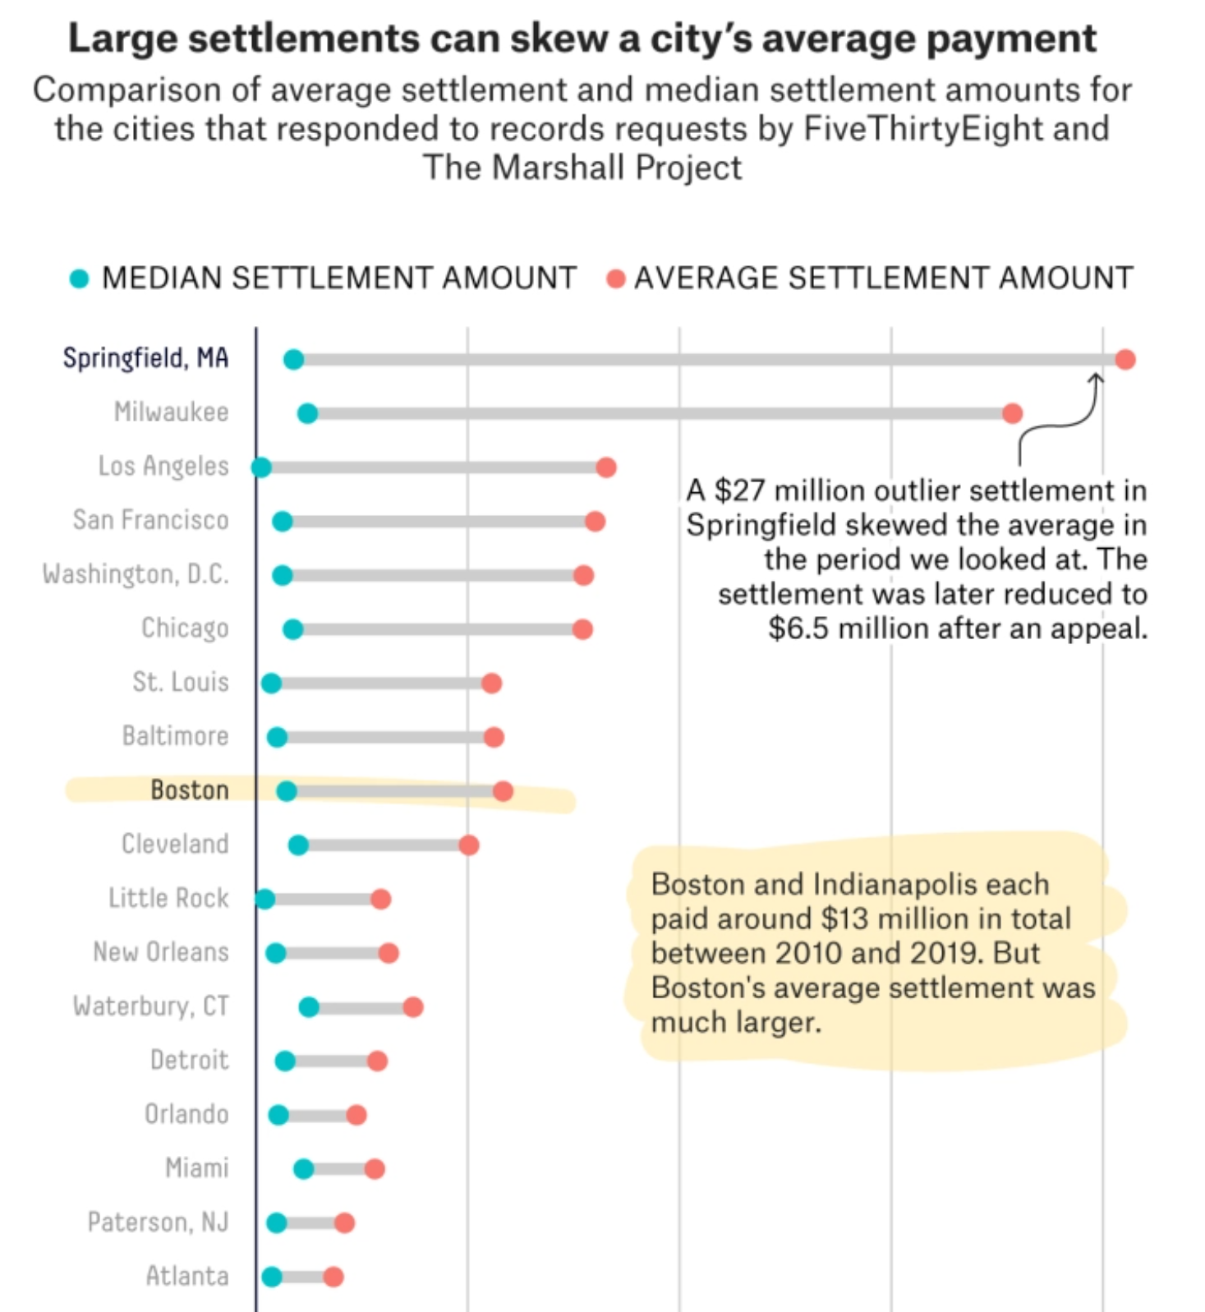
Measuring the Middle
Notes:
Mean, Median, Mode

Slide 78
Dispersion and Deviation
Standard deviations describe Dispersion
How is the data dispersed around the mean
Low standard deviation – values are clustered close to the mean
High standard deviation – values are spread out away from the mean
A “normal” distribution looks like the classic bell curve

Slide 79
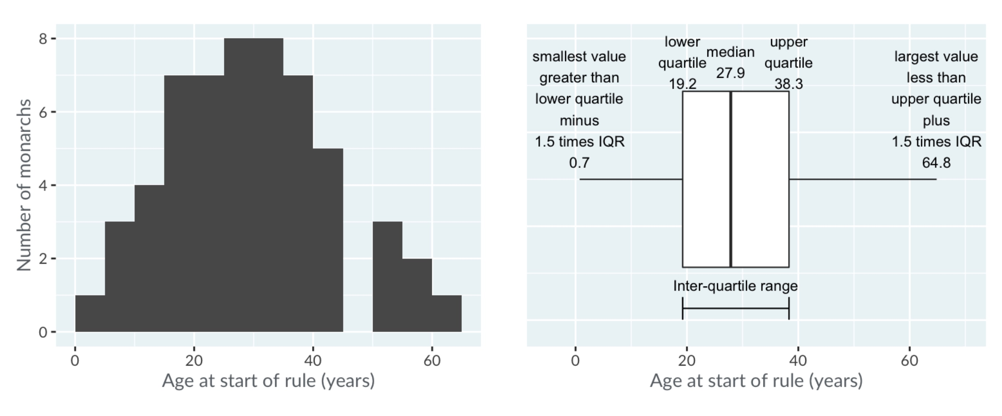
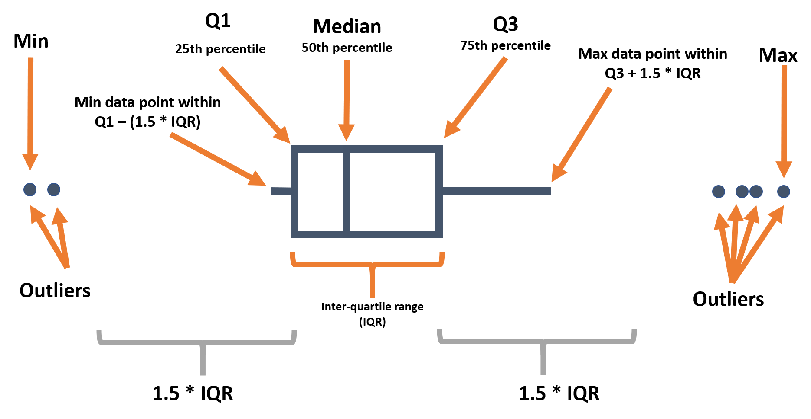
Boxplots

Slide 80
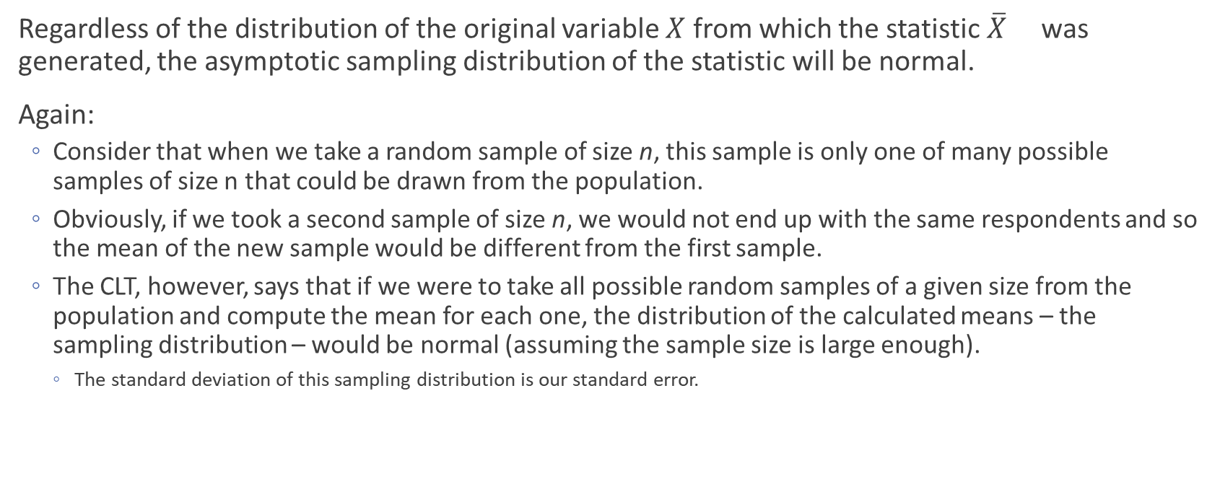
Central Limit Theorem
Regardless of the distribution of the original variable $X$ from which the statistic $\overline{X}$ was generated, the asymptotic sampling distribution of the statistic will be normal.
Again:
Consider that when we take a random sample of size n, this sample is only one of many possible samples of size n that could be drawn from the population.
Obviously, if we took a second sample of size n, we would not end up with the same respondents and so the mean of the new sample would be different from the first sample.
The CLT, however, says that if we were to take all possible random samples of a given size from the population and compute the mean for each one, the distribution of the calculated means – the sampling distribution – would be normal (assuming the sample size is large enough).
The standard deviation of this sampling distribution is our standard error.
Notes:
From Siciliano’s notes

Slide 81
Central Limit Theorem
Regardless of the distribution of the original variable $X$ from which the statistic $\overline{X}$ was generated, the asymptotic sampling distribution of the statistic will be normal.
Again:
Consider that when we take a random sample of size n, this sample is only one of many possible samples of size n that could be drawn from the population.
Obviously, if we took a second sample of size n, we would not end up with the same respondents and so the mean of the new sample would be different from the first sample.
The CLT, however, says that if we were to take all possible random samples of a given size from the population and compute the mean for each one, the distribution of the calculated means – the sampling distribution – would be normal (assuming the sample size is large enough).
The standard deviation of this sampling distribution is our standard error.

Slide 82
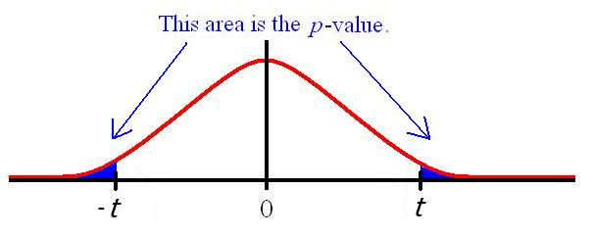
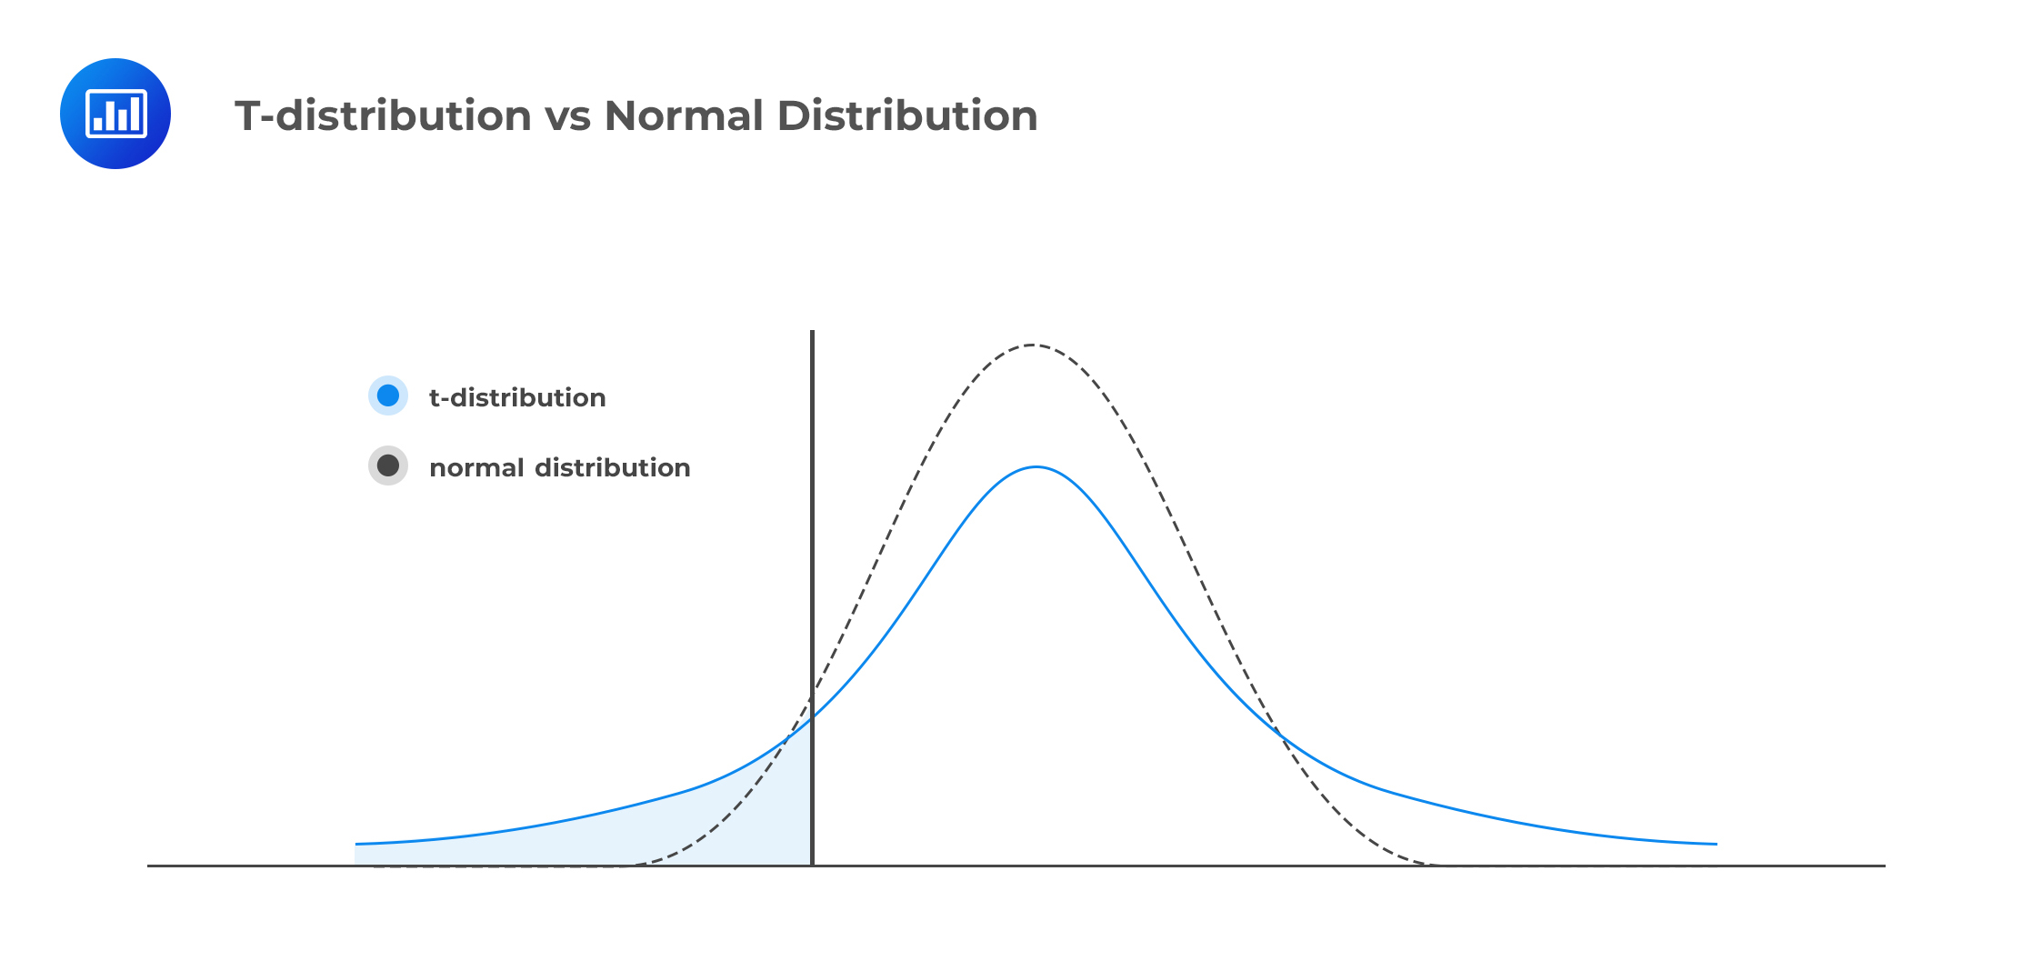
The larger the sample size, the more “normal” the t distribution becomes
=> the areas in the tails shrinks
Smaller tail => less of the distribution falls outside of the confidence interval at set confidence levels.

Slide 83
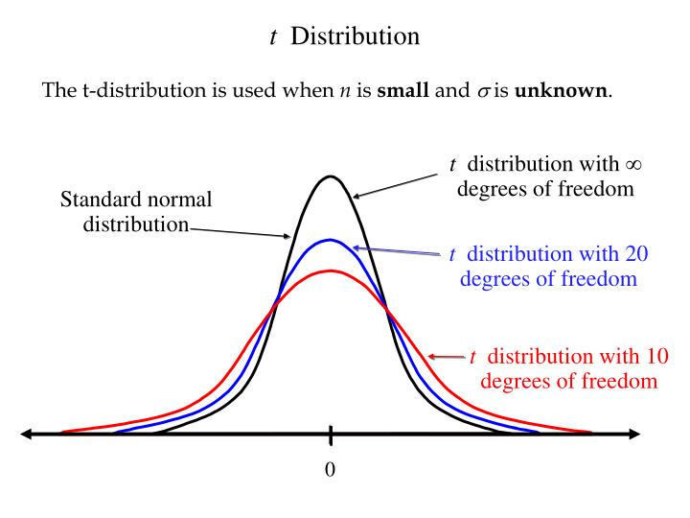
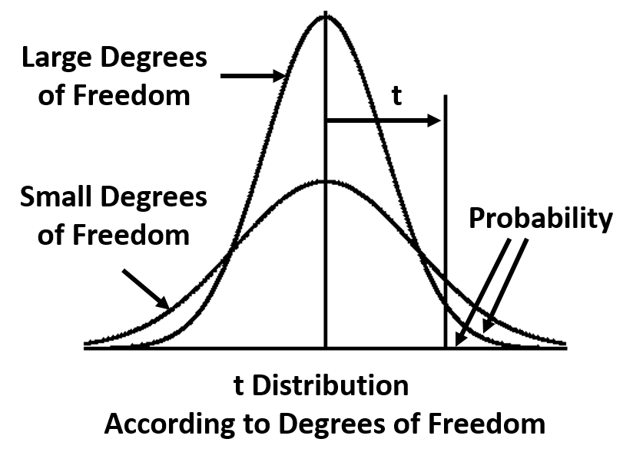
Larger sample size
More degrees of freedom
More normally distributed (the curve becomes taller and skinnier)
Ultimately can become more confident that your results didn’t happen by chance

Slide 84
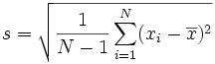
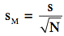
Example: City residents have been asked to report the number of community organizations of which they are members (e.g., churches, PTAs, civic organizations, etc.). Below is are the values observed for a sample of 20 cases for this variable.
1, 2, 2, 3, 3, 3, 4, 4, 4, 5, 5, 5, 5, 6, 6, 6, 7, 7, 8, 8
Calculate the following:
N (sample size)
Mode
Median
Mean
Sample standard deviation
Range
Minimum and maximum
Standard error of the mean
Draw a histogram of the distribution

Slide 85
1, 2, 2, 3, 3, 3, 4, 4, 4, 5, 5, 5, 5, 6, 6, 6, 7, 7, 8, 8
N (sample size): Number of observations ➔ N=20
Mode: Most frequent value ➔ Mode =5
Median: Middle value ➔ Median = 5
1, 2, 2, 3, 3, 3, 4, 4, 4, 5, 5, 5, 5, 6, 6, 6, 7, 7, 8, 8
Mean = Average ➔
(1+2+2+3+3+3+4+4+4+5+5+5+5+6+6+6+7+7+8+8)=94/20=4.7

Slide 86
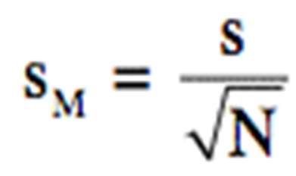

Sample standard deviation
(1-4.7)²=13.69
(2-4.7) ²=7.29
(2-4.7) ²=7.29
(3-4.7) ²=2.89
(3-4.7) ²=2.89
(3-4.7) ²=2.89
(4-4.7) ²=.49
(4-4.7) ²=.49
(4-4.7) ²=.49
(5-4.7) ²=.09
(5-4.7) ²=.09
(5-4.7) ²=.09
(5-4.7) ²=.09
(6-4.7) ²=1.69
(6-4.7) ²=1.69
(6-4.7) ²=1.69
(7-4.7) ²=5.29
(7-4.7) ²=5.29
(8-4.7) ²=10.89
(8-4.7) ²=10.89
Sum=76.2
S=sqrt((1/19)*76.2)=2.0026…
1, 2, 2, 3, 3, 3, 4, 4, 4, 5, 5, 5, 5, 6, 6, 6, 7, 7, 8, 8
Minimum and maximum: 8 and 1
Range (8-1)=7
Standard error of the mean = 2.00/(sqrt(20))=.447

Slide 87
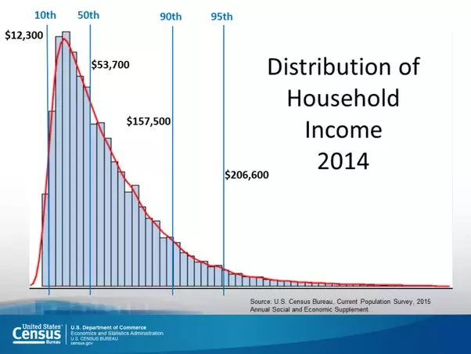
Create a new one in R with current data from ANES?

Slide 88
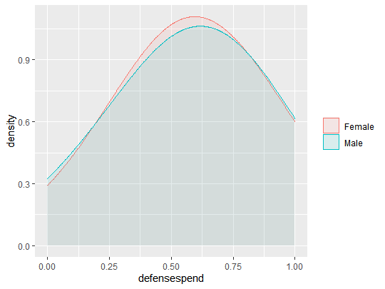
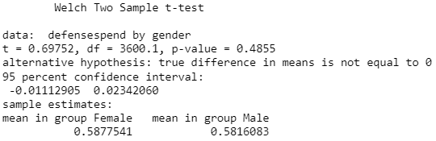
Preferences of spending on defense by gender
Notes:
Interpretation: there is not a statistically significant difference between genders on preferences for defense spending.

Slide 89

Preferences for Spending on Defense for Democrats and Republicans
Notes:
There is a statistically significant difference in the preferences for spending on defense between democrats and republicans.

Slide 90
Practice Questions
What was the maximum number of megawatts produced by coal during one hour?
On average, what percent of ERCOT’s total megawatts come from natural gas each day? From wind?
Avg gas drops 7,407 MWh. Wind drops 2,535 MWh
What was the percent change from February 15 to February 16th for each power source?

Slide 91
Research Question: V161178 vs. V161181
Research Question: Is there a difference in spending level preferences for defense spending and spending on social services?
V161178: 7pt scale spending on services self-placement
Government should provide fewer services → 7. Government should provide more service.
V161181: 7pt scale defense spending self-placement
Government should decrease defense spending → 7. Government should increase defense spending
Notes:
Data from ANES 2016, available for download online.

Slide 92


Notes:
In future courses, you’ll learn how to test if they are different enough that it is unlikely to happen by chance (statistically significant difference).

Slide 93

Notes:
Add to whenever we are talking about surveys

Slide 94
Week 4 – Calculating Change

Slide 95


Slide 96


Slide 97
Cleaning Dates

Slide 98


Calculating Change

Slide 99
Percentage vs. Percentage Points
Percentage
A price decrease of 100% means the price has dropped to $0. A decrease of 200% means someone is now paying you the same amount you used to pay them.
Percentages have to be applied to the same baseline in order for them to be equivalent.
Cutting the salary of a position by 50% can not be restored by increasing it by 50%.
A 50% decrease of $1000 = $500.
A 50% increase of the $500 is only $750.
Percentage Points
If interest rises from 3% to 4%, it has increased 1 percentage point, OR 33% (1 percentage point is 1/3 of the original baseline of 3 percent)
If interest falls from 4% to 3%, it has decreased by 1 percentage point, OR 25% (1 percentage point is 1/4 of the baseline of 4.
Be careful when reading about or using these terms to describe something!

Slide 100
Percentages
What percentage of a school districts budget is spent on salaries, maintenance, instructional materials, etc.?
What percentage of instructional spending goes towards different subjects(band, science, sports, etc.)?
Percent of GDP spent on health care
Percent of a city budget spent on policing
Two vastly different cities may have very different budget structures and revenue sources. It may be more meaningful to compare the amount spent on policing per citizen.

Slide 101
Sales tax increases from 4% to 6%.
Increases by 2 percentage points
It also increased by 50% (increased 2 / baseline 4)
To make it sound small, call it a 2 percentage point increase.
To make it sound large, people may say that the sales tax increased 50%

Slide 102
Meaningful Comparisons
Breitbart headline – proclaimed that 2,139 of the DREAM Act recipients had been convicted or accused of crimes against Americans.
In comparison….
~700,000 people held DACA status concurrently (at the same time) and so far, nearly 800,000 people have been granted DACA status at some point in time.
0.3 percent of all DACA recipients have been accused of crimes (1 in 300)
US citizens have twice as high of a chance of being arrested (0.75 percent) as DACA recipients are to have been accused of a crime.
About 8.6% of all American citizens have been convicted of a felony at some point in their lives.
However, DACA recipients are younger and have had less time to commit crimes compared to all Americans. BUT 30% of Americans have been arrested for something other than traffic violations by age 23.
So even if Breitbart’s headline was correct, without context they are not meaningful or honest
Notes:
2,139 who lost DACA status when “Calling Bullshit” was published due to felony or misdemeanor convictions, arrests, or suspected affiliation. – 85
To be eligible for DACA status, one must not have been convicted of a felony, or significant misdemeanor, or three misdemeanors of any kind.

Slide 103
Relative Risk
If it’s a bad flu year (when the vaccine doesn’t match the annual flu variety), the flu rate is around be 4% for unvaccinated and 1% for vaccinated people.
During a good flu year, when the vaccine works the most effectively against the flu, 2% of unvaccinated people get sick and 1% of vaccinated people catch the flu.
A person online was questioning the importance of the influence vaccine because when they are mismatched, only 1 in 100 people benefited from the vaccine effort. It only reduces influenze cases by 1 less person per 100 people.
If we think the flu vaccine is helping only 1 in 100 people, is it worth it? Well compared to 2% of people getting the flu if they are unvaccinated, 50% of the number of people will have the flu.
A 1 percentage point decrease = a 50 percent decrease in the number of flu cases
Notes:
Calling bullshit pg 89
Since 2010, CDC estimates that the influenze rates have ranged from 3% to 11%.

Slide 104
The use of seatbelts drops the annual risk of injury from “only” 2% to 1%. This also decreases them by half.
2000: 12.9% of the US population was Black but 41.3% of the inmates in US jails were Black.
2005: 38.9% of all inmates were black.
At first glance, this seems like progress, but unfortunately the number of Black individuals in US jails increased by more than 13%.
The number of whites in US jails increased by 27%. This shifted the overall percentages of inmate demographics.
In 2005, the raw number of people in jail increased, but the proportion of inmates who are Black decreased slightly compared to what it was in 2000 (there are still an extremely disproportionate number of Black individuals in jail).
Notes:
Shows issue of comparisons that involve fractions or percentages.
Changing denominators hide changes in numerators.
The numerator, number of jailed Black Americans, increased a lot, but the denominator increased by an even larger proportion. Pg 90.

Slide 105
Scott Walker claimed in June 2011 that 50% of the nation’s job growth had occurred in Wisconsin.
But…. Many US states lost jobs overall, while others gained, which almost balanced out. There was a net increase of only 18,000 jobs in the entire United States. Wisconsin had a net growth of 9,500 jobs that year, so he claimed that Wisconsin job growth was over half of the size of the country’s net growth.
Despite his claim, only a small fraction of the total jobs created in the country were created in Wisconsin.
Notes:
Calling Bullshit, pg 92

Slide 106
Lab

Slide 107
Wednesday Lab
Data: World Inequality Database
Cleaning List:
Delimited file -> Excel table
Reformat Text -> Numbers

Slide 109
Creating Variables

Slide 110
Index and Scales

Slide 111
Unit of Analysis

Slide 112
Correlation

Slide 113


Slide 114


Slide 115
Correlation
The extent to which two continuous (interval or ratio level) variables are related
A relationship exists when knowing the value of one variable is useful in predicting the value of a second variable
Linear relationship – change in one variable corresponds to change in the other variable (same across the range of the variable)
Nonlinear relationship – change in one variable corresponds to change in the other variable (not the same across the range of the variable)

Slide 116
How This Thing Changes with That Thing
Every time we adjust one thing, another thing changes.
When children eat a nutritional breakfast five days a week, test scores increase by three points.
These two things are totally interrelated.
Based on the current pattern, we predict moderate growth over the next quarter.
The more I exercise, the better I feel.
These outliers don’t fit the pattern and may be worth investigating

Slide 117

Correlation
Positive association – as the value on one variable goes up, the value on the other variable goes up
Negative association – as the value one variable goes up, the value on the other variable goes down

Slide 118


Slide 119
Examples of curvilinear relationships:
Watering and plant growth
Amount of money spent per student and student performance (diminishing returns)
Income and age often curvilinear relationships
Income – diminishing returns (effect of difference between income of $10k and $11k not the same as difference between $100k and $101k)
Age – cognitive ability, attitude strength

Slide 120
Strength of correlation or relationship
Ranges from -1 to +1
A correlation of -1 or +1 between x and y would mean that knowing the value of a case on x would allow you to perfectly predict the case’s value on y
Value of 0 means no association

Slide 121
What affects the strength of a relationship?
The actual strength of the association.
The reliability of the measures being used:
Measurement error = True score – Observed score
Systematic error – e.g., social desirability bias
Random error – e.g., random contextual factors
Use of multiple measures
Reliability – Chronbach’s alpha measure of reliability
Number of items
Degree of relatedness across items

Slide 122


Slide 123
Correlation versus regression:
Correlation
No assumption about IV and DV
Typically used to describe the relationship between two variables
Regression
Identifies one variables as the DV and one (or more variables as IVs or control variables)
Can be used to test the effects of multiple independent variables on a dependent variable.
Parametric – ordinary least squares regression, but many, many variants
Most more advanced analysis techniques are extensions of regression
Correlation between two variables = Bivariate regression between same two variables
Bivariate regression
produces regression coefficient rather than correlation coefficient
Unstandardized regression coefficient is the amount of change in the dependent variable that corresponds to one unit of change in the independent variable

Slide 124

Correlation - Excel
Highlight the two columns you want to plot
Add labels,
Add SOME labels for outliers or to highlight key datapoints
- Right click “Add Data Label”, semi transparent label and select Format data labels – Click inside menu with paint bucket
Summary Sentence:
Notes:
Effective Data Visualization pg 335
RadicalMath.org – social justice based data
Data included in Evergreen’s Practice file
Conrad Carlberg pg 39 & 86

Slide 125
Standardardized coefficient
Standardardized coefficient: reporting amount of change in the dependent variable for one unit of change in the independent variable, where both variables are expressed in terms of standard deviations
What this means that this coefficient represents the relationship if you converted both variables to z-scores (which you can do for normally distributed variables). Remember that the z-score represents a values deviation from the mean of the sample in standard deviation units (so z=1.0 represents a score one standard deviation above the mean).

Slide 126
Using Multiple Measures
Can increase the reliability and validity of measures
Multiple ways that measures can be combined
Often multiple items in a scale (e.g., self-esteem; extroversion)
Most commonly averaged into an index
Preliminary step → assess scale reliability
Do the multiple items really assess the same underlying construct or idea?

Slide 127
Index vs. Scale
Scale:
Likert scale is the most common
Ex.) Strongly Disagree/Disagree/Neither Disagree or Agree/Agree/Strongly Agree
Index:
Multiple variables that reflect the same concept, combined into one variable
Creating an Index:
Make sure variables run in same direction, ideally low values mean lower levels of something
Add variables together.
Ex.) 5 variables that each have five values create an index that can have a range from:
5 to 25 OR 1 to 5 OR 0 to 1
Notes:
Likert scale: Fogarty pg. 62
5 to 25
- From just adding the values for all 5 selections. If they chose 5 for the 5 questions, then they have score of 25. If they chose 1 for all 5 questions, then they have a score of 5. If they chose 4 for all 5 questions, then they have a score of 20. etc.
OR 1 to 5
Add them all up and then divide by 5 to get an average
Easy to compare index to original questions
OR 0 to 1
- Subtract 1 so all responses are between 0 and 4
Add them all up and then divide by 20 to get their score on a range of 0 to 1.
Useful for regression to have all variables only have a range of 0 to 1.

Slide 128
Validity & Reliability
Construct Validity
Should these items be combined?
Is there theory or previous research saying the items measure an underlying construct?
Racial resentment example index in future slides
Measurement Reliability
Alpha coefficient for reliability!
How much do the items “agree” with each other?
Notes:
Just because something is highly correlated, does not mean that the items should be combined into an index. Examples on next slides.

Slide 129
Government Trust Index (excel

Slide 130
Data Visualization

Slide 131

Summary Tables

Slide 132
Good and Bad examples

Slide 133
Create multiple graphs from the same data

Slide 134
Merging and Common Identifiers

Slide 135
Vlookup()

Slide 136
Dashboards and Communicating Information

Slide 138
Central Tendency & Variance in R

Slide 139
Comparing Variables
Research Question: Is there a difference in spending level preferences for defense spending and spending on social services?
V161178: 7pt scale spending on services self-placement
Government should provide fewer services → 7. Government should provide more service.
V161181: 7pt scale defense spending self-placement
Government should decrease defense spending → 7. Government should increase defense spending
Notes:
Null hypothesis: There is not statistically significant difference in means.
Alternative hypothesis: There is a statistically significant difference in means.

Slide 140
Example 4

Slide 141


Notes:
ggplot(ANES) +
# Top
geom_density(aes(x = defensespend, y=..density..), adjust=4, fill="blue", alpha=.4) +
# Bottom
geom_density( aes( x = servicespend, y=..density..), adjust=4, fill="green", alpha=.4)+
ggtitle("Distributions of Spending Preferences for Social Services and Defense") +
scale_x_continuous(name = "Gaussian Distribution of Survey Responses")+
scale_y_continuous(name = "")

Slide 142
Example: Correlation between feeling thermometers between feeling thermometer rating of mayor and local city police (0-100)
Pearson correlation coefficient: r=.141
Statistical significance: p-value=.0001
Sample size: N=1993
Pearson correlation coefficients:
Range from -1 to +1
Is unaffected by the scale of the variables (interpretation affected by direction of coding)
Interpreting the “size” of coefficients
Affected by theory
Affected by actual size of effect and also measurement error

Slide 143
The base function for correlations in R is simply cor() followed by the y and x variables.
Pearson’s correlation, which provides a correlation coefficient (r) for a linear relationship; thus it assumes a linear relationship between x and y.
Correlation analysis provides a coefficient that tells us, on average, how much two variables (x and y) move together relative to their respective means.
The sign of r simply tells us whether the relationship is positive or negative
We can also use r to determine the amount of variance explained in our outcome variable from our predictor variable R2 which is called the coefficient of determination.
Notes:
Pg. 281?
We can also test for statistical significance in correlation analysis. This tells us whether the correlation we observe in our sample data is expected to be true in the population. The main caveat is that even if
we find there is a significant correlation, we are only comparing two variables in isolation and not taking into account other factors; more on this in the next chapter. Further, if we have an outcome variable on the interval/ratio level, and particularly if we have a predictor variable on the interval/ratio level, we are better off using linear regression (specifically, multiple regression, as we will in the next chapter) than correlation analysis.

Slide 144
Data visualization

Slide 146
Make a scatter plot
A lot of the code used previously can be re-used for the scatter plot. Two main differences are the following:
Because we now have an additional variable, we need to assign a y = for the aes( ) command within ggplot( ).
Create the plot so that Celery_Eaten will be on the y-axis.
Add (+) a geom_point( ) element instead of geom_hist( )
Also, we will add lines to our plot, representing the mean of each variable. Here’s how we’ll do that:
Add a horizontal line by adding (+) a geom_hline( ) component. This takes the argument yintercept =, which equals the value for where the horizontal line should cross the y-intercept.
Since we want to place this line at the mean of y variable (y¯y¯), we can use the mean( ) function instead of specifying a numeric value directly.
Add a vertical line by following the same structure as above but using geom_vline( ) and xintercept = instead. This vertical line will represent the mean (x¯x¯) of the heights.
Notes:
It’s difficult to get an idea if there’s any relationship by just looking at the data frame. We learn a lot more from creating a plot. Use ggplot to make a scatterplot.

Slide 147

Deviations
Why do we use the deviations? Because we want to know whether the x-values and y-values move together with respect to their means or not. For example, when an observation’s deviation on x is above x¯, will its deviation on y also be above y¯? Using this line of thought, we can begin to systematically characterize how “together” the x and y values will change as we go through all observations.
Notes:
Image from teacup giraffe website

Slide 148
Cross Products
2. Multiply the two deviation scores. This is called the crossproduct. The shapes created by the crossproduct will serve as the “squared” terms that we can then use in the next step to sum and summarize the deviations into a single value
3. Sum the crossproducts. The sum of the crossproduct gives us a single number.
4. We then divide the sum of the crossproduct by n−1 (or N in the population equation) so that we have taken into account how many observations contributed to this quantity. (Why n−1? See here.) This final number is called the covariance, and its value tells us how much our two variables fluctuate together. The higher the absolute value, the stronger the relationship.

Slide 149
Covariance
Covariance measures how two variables change together. It is one tool to measure the relationship between two variables (and its strength).
Covariance uses the deviations of observations from two different variables
We observe this below with a subset of 5 points from our scatter plot. Positive deviations are shown in red, negative deviations in blue.
Notes:
As we did for the variance, we begin by measuring how far each observation lies from its mean. But unlike when we calculated the variance, each observation now includes two variables. We will need to calculate the observation’s distance from each variable’s mean. We call each distance the deviation scores on x and on y, respectively. Like the variance, the observation can fall above or below the mean, and as a result the corresponding deviation score will have either a positive or negative sign.

Slide 150


Pearson correlation coefficient
How do we standardize the covariance?
The solution is to (1) take the standard deviations of each variable, (2) multiply them together, and (3) divide the covariance by this product – the resulting value is called the Pearson correlation coefficient. When referring to the population correlation coefficient, the symbol ρ (pronounced “rho”) is used. When referring to the sample correlation coefficient, a lowercase r is used (often called “Pearson’s r”).
Here is the equation for the population correlation:
This equation is used for the sample correlation:

Slide 151

Meaning of Correlation
We can interpret the correlation as a measure of the strength and direction of the relationship between two variables. It is a “standardized” version of the covariance.
The correlation will always be between -1 and 1. At these extreme values, the two variables have the strongest relationship possible, in which each data point will fall exactly on a line. When the absolute value of the correlation coefficient approaches 0, the observations will be more “scattered”.
The sign of the correlation coefficient indicates the direction of the linear relationship. When r= 0 there is no relationship between the variables. Look at the figure below to see what observations of different r values look like.

Slide 152
Your turn
What would you say about this correlation?

Slide 154





Slide 155
Data Visualization in R

Slide 156

Dashboards
Notes:
File: dashboards.rmd
Originally from flexdashboard example online.

